Slide 1

4a. Properties of negative downward lightning discharge to ground - I
1

Slide 2
Course Sections | Number of Lectures | HW Due (Can-vas) | Test (Honor-lock) | Section in Course Packet | Chapter/ Sections in Text (FOL)
Introduction | 1
1. Types of lightning discharges and lightning terminology | 4 | HW1 01/25 | T1 01/27 | 1 | 1, App. 1, 4
2. Incidence of lightning to areas and structures | 4 | HW2 02/05 | T2 02/08 | 2 | 2, Sect. 9.3
3. Electrical structure of thunderstorm clouds | 6 | HW3 02/22 | T3 02/24 | 3 | 3, App. 2
4a. Properties of the negative lightning discharge to ground - I | 5 | HW4 03/08 | T4 03/10 | 4a | 4.1-4.3, 4.6, 4.10
4b. Properties of the negative lightning discharge to ground – II | 4 | HW5 03/19 | T5 03/22 | 4b | 4.4-4.5, 4.7-4.10, 9.3

Slide 3
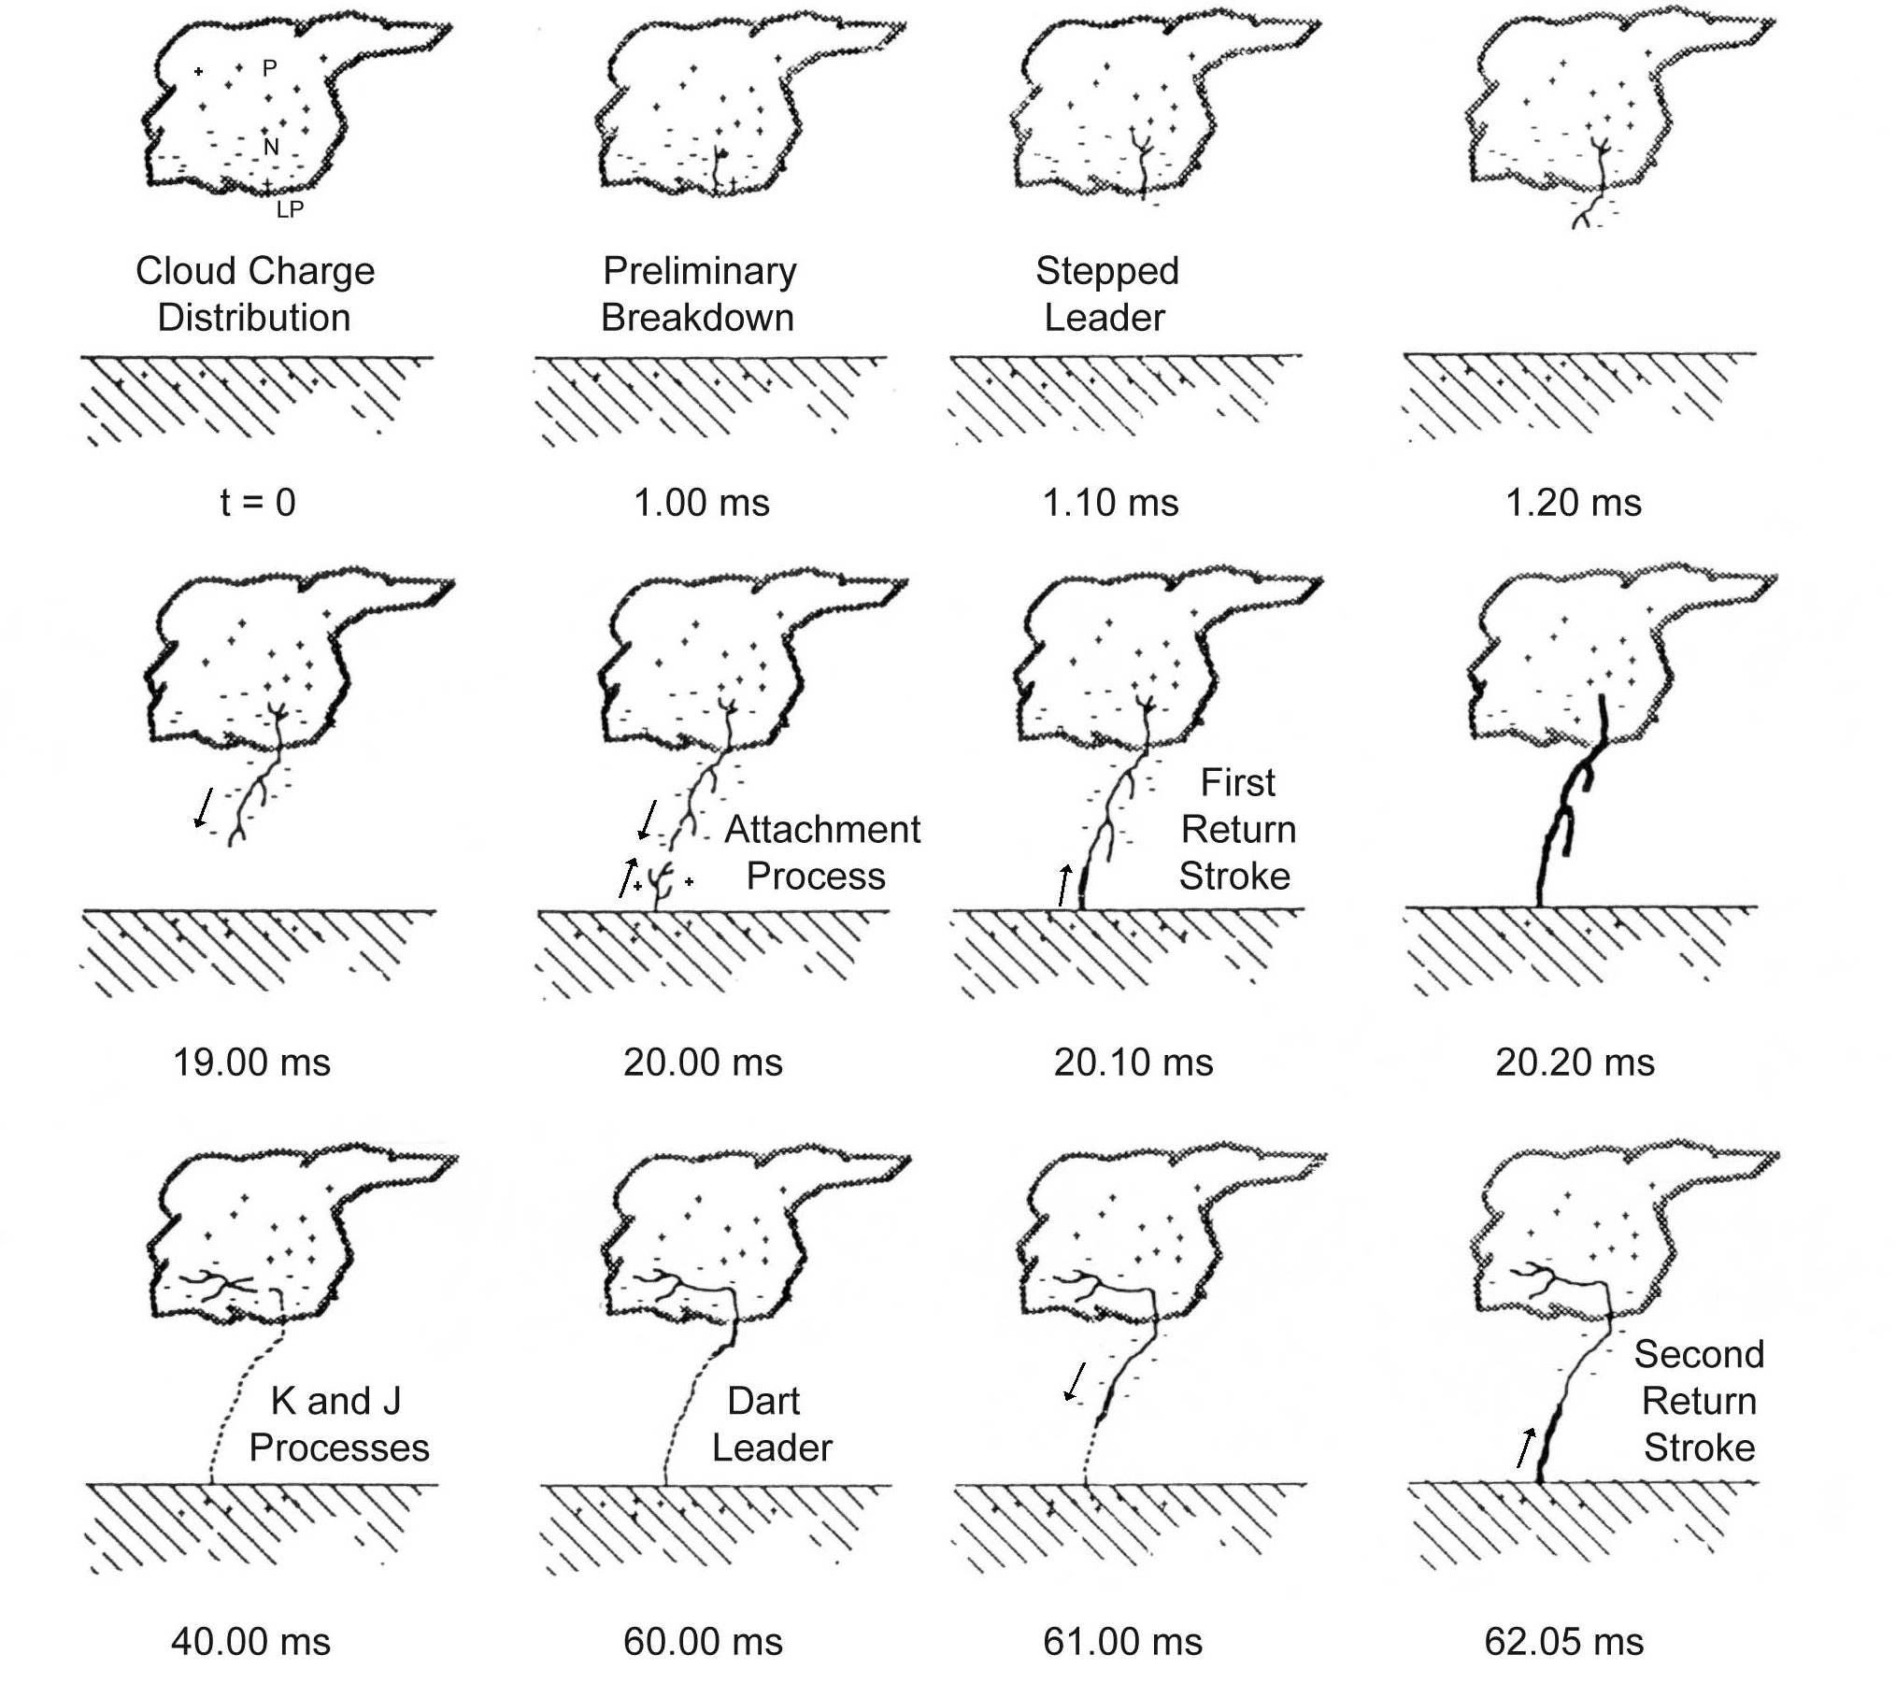
Downward Negative Lightning Discharge to Ground (-CG)
Section 3
Section 4a
(PB and
Leaders)
Cloud Charge Distribution
Preliminary
Breakdown
Stepped
Leader
t = 0
1.00 ms
1.10 ms
1.20 ms
Attachment
Process
First Return
Stroke
Section 4b
(AP, Return
Stroke, K and
J Processes
19.00 ms
20.00 ms
20.10 ms
20.20 ms
K and J Process
Dart
Leader
Second Return
Stroke
40.00 ms
60.00 ms
61.00 ms
62.05 ms
A drawing illustrating various processes comprising a negative cloud-to-ground lightning flash (not shown are continuing current and M-components). Adapted from Uman (1987).
3
Notes:
3

Slide 4
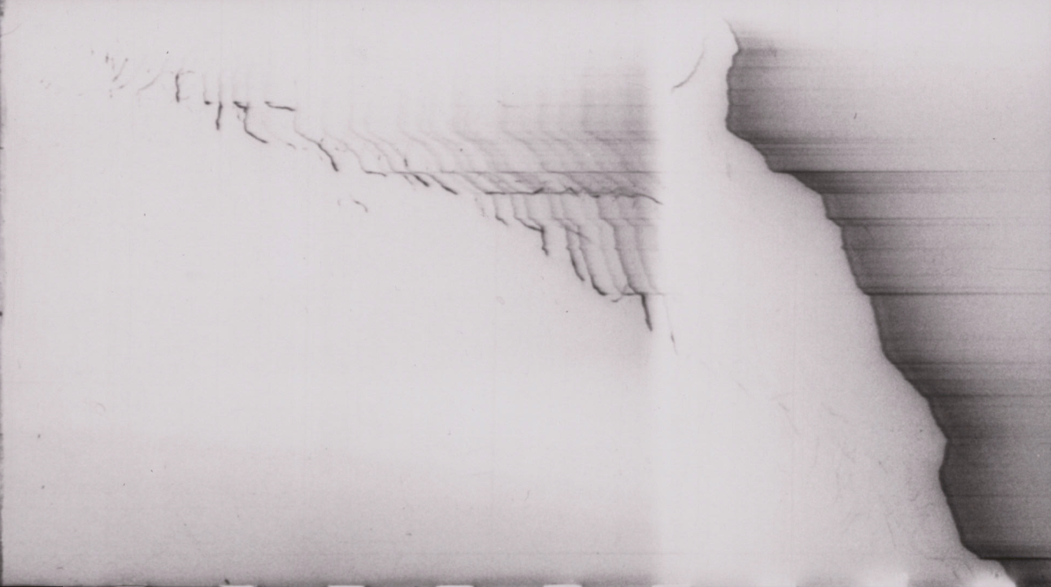
Return
stroke
360 m
Stepped leader →
1 ms
Time
Streak-camera photograph of a downward negative stepped leader within 360 m of ground. Time advances from left to right. The left part of the photograph was overexposed in the reproduction process in order to enhance the intensity of the early portion of the leader image. Adapted from Berger and Vogelsanger (1966).
Notes:
4

Slide 5
Sketch of the step formation process inferred from 300 kiloframes per second (3.3-us exposure, r = 1 km) high-speed video records of natural lightning at Camp Blanding, Florida. Adapted from Hill et al. (2011).
Gamerota et al. (2014), using HS video records (648 kfps, 1.16 us exposure time and 380 ns dead time, r = 300 m), imaged bidirectional space leaders (the average speeds were 8.4 x 10⁵ m/s upward and 4.8 x 10⁵ m/s downward) in triggered lightning at Camp Blanding, Florida.
Positive: E_{cr} = 5 kV/cm
Negative: E_{cr} = 10 kV/cm
Negative leader stepping process

Slide 6
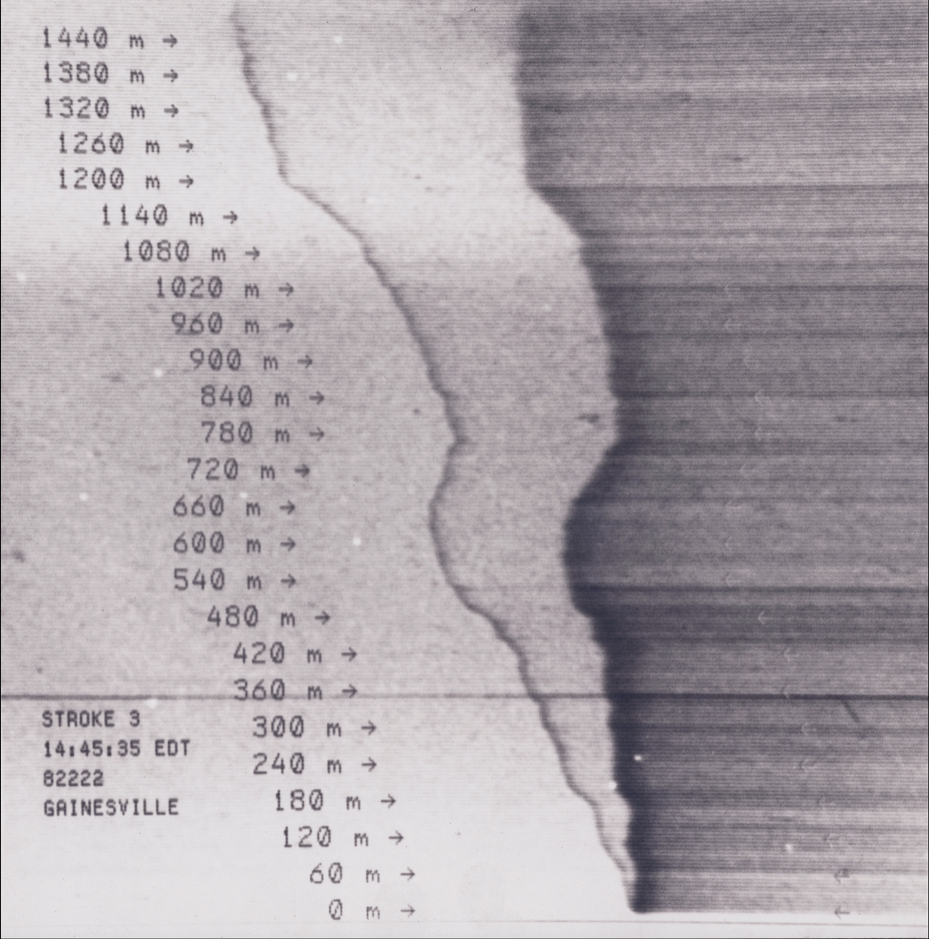
Dart
leader
Return
stroke
Nonlinearity of lightning channel
1 – 3,000 K
R = 18 kΩ/m
2 – 20,000 K
R = 3.5 Ω/m
3 - >30,000 K
R = 0.035 Ω/m
1
2
3
← Ground termination point
Streak photograph of stroke 3 in a flash that occurred in Gainesville, Florida on 10 August 1982. the image on the left is due to the dart leader, and the brighter image on the right is due to the return stroke. Adapted from Jordan et al. (1997).
Notes:
6

Slide 7
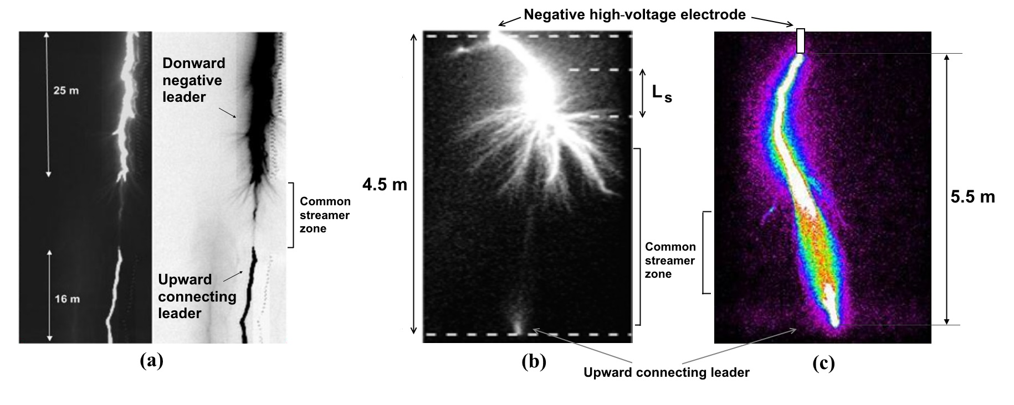
Break-through phase of the attachment process in rocket-triggered lightning and in long laboratory sparks. (a) shows the original and inverted-intensity versions of the high-speed video frame (20-µs integration time) just prior to the return-stroke frame of a negative triggered-lightning stroke. (b) and (c) are single frames of two negative laboratory sparks captured by image converter camera K008 with frame durations of 2 µs and 0.2 µs, respectively. L_{s} in (b) is the length of just-formed step (note the burst of negative streamers from the lower end of the step) of the downward negative leader. In (c), light intensity is color coded, with the highest intensity shown in white. The common streamer zone (a faint lament in (b), which is difficult to see in a reproduction) between the downward leader channel and the upward connecting leader channel is imaged in all three cases. Images shown in (a), (b), and (c) are adapted from Biagi et al. [2009], Lebedev et al. [2007], and Shcherbakov et al. [2007], respectively.
Rocket-triggered lightning
Long laboratory sparks

Slide 8
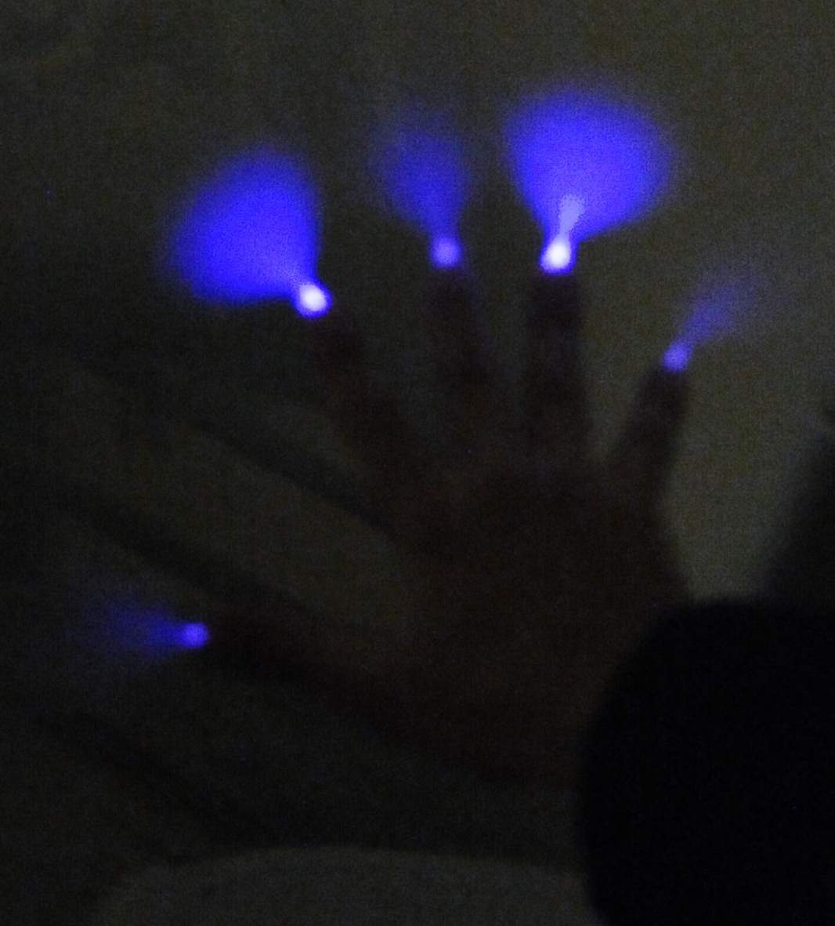
Corona from a human hand
Corona discharge from a human hand in laboratory (Istra, Russia). Electric field was produced by a cloud of negatively-charged water droplets. The hand was at a distance of 3 to 5 m from the cloud edge. Courtesy of Dr. A. Kostinskiy.

Slide 9
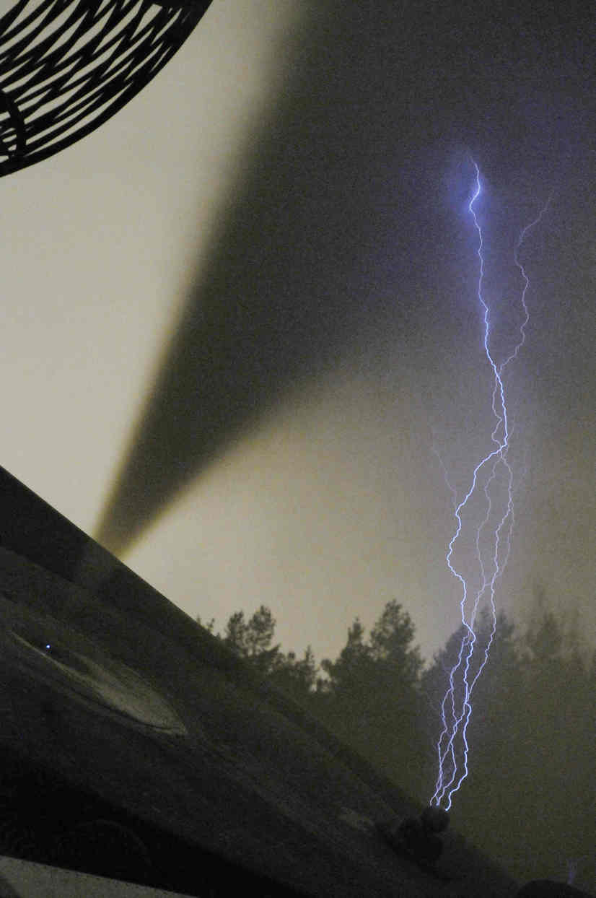
Still picture (visible range; 5-s exposure) of negatively charged cloud (slanted jet-like, dark formation) and four upward positive discharges, about 1.5 m in length, triggered from the nearby grounded sphere. Adapted from Kostinsky et al. (2015)

Slide 10
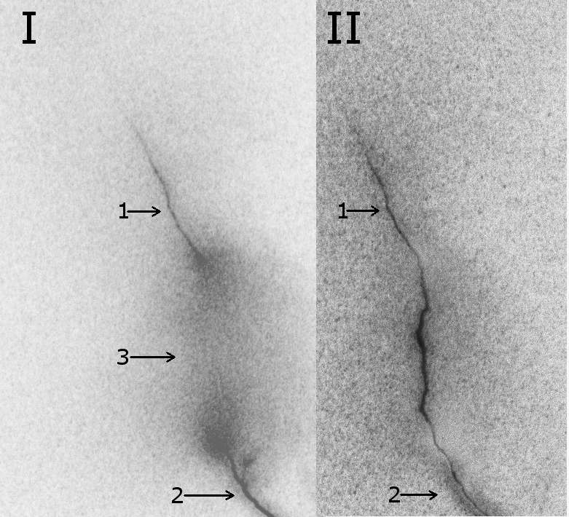
Two frames of ultra-high-speed intensified CCD camera (4Picos, r = 3 m) showing the onset of break-through phase of the 1.5-m spark attachment process (I) and post-return-stroke stage (II). Exposure of each frame is 100 ns, the time between frames is 2 µs.
1 and 2 – negative and positive leaders, respectively (the distance between leader tips is about 17 cm); 3 – common streamer zone.
Adapted from Andreev et al. (2014).

Slide 11
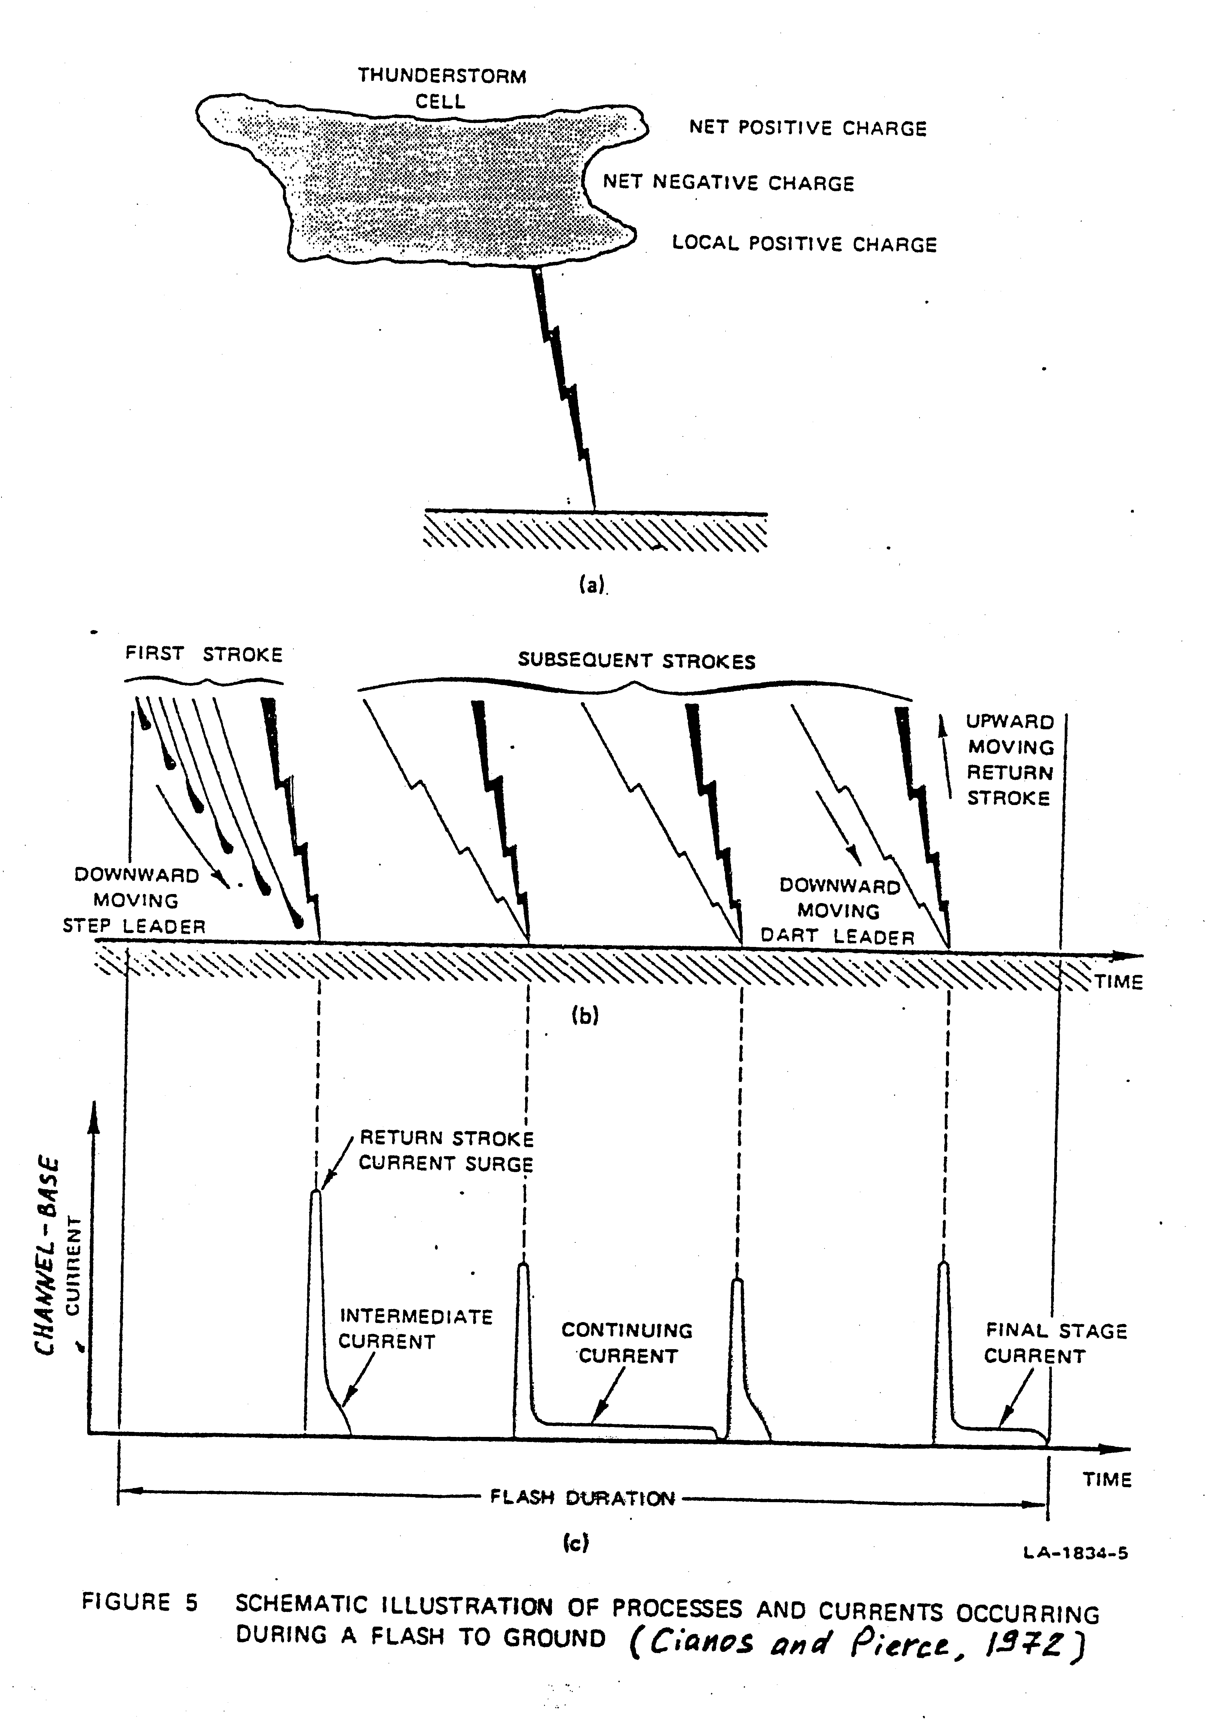
Static optical image
Time-resolved
optical image
Stepping→
Current record (impulsive components typically last for tens of microseconds, while
interstroke intervals are tens of milliseconds)

Slide 12
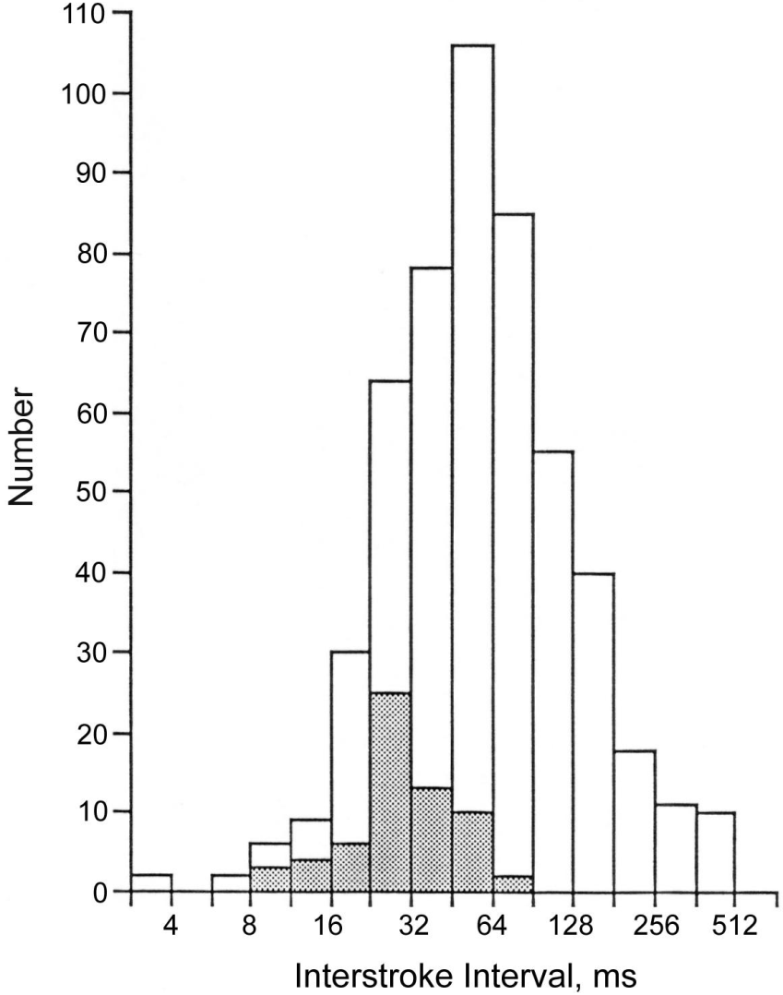
Interstroke Intervals
Histogram of 516 interstroke intervals in 132 flashes in Florida and New Mexico (GM is about 60 ms). Intervals preceding strokes that initiated long continuing currents are shown shaded (GM is about 30 ms).
12
Notes:
12

Slide 13
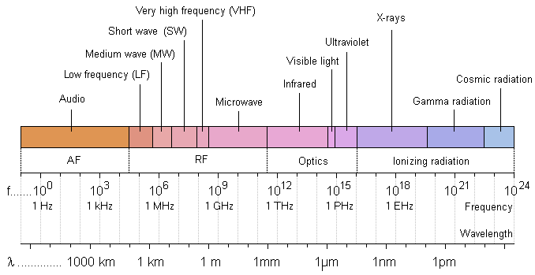
The Electromagnetic Spectrum
Various lightning processes emit electromagnetic signals with a peak in the radio-frequency spectrum at 5 to 10 kHz, when observed at distances beyond 50 km or so. At frequencies higher than that of the spectrum peak, the spectral amplitude varies approximately inversely proportional to the frequency up to 10 MHz or so and inversely proportional to the square root of frequency from about 10 MHz to 10 GHz (Cianos et al. 1973 ).
13

Slide 14
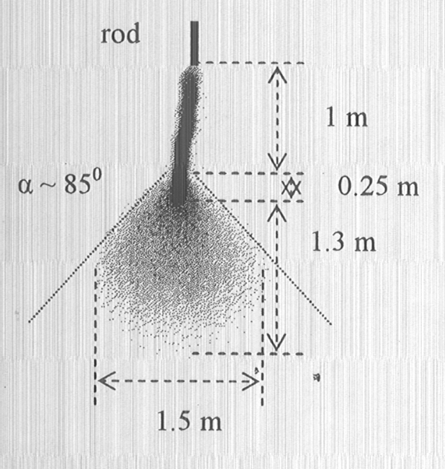
Streamer zone of positive leader
+
Thermally ionized channel
Leader tip
Streamer zone
Positive leader in a 5.5 m rod-plane gap (image converter camera K004; negative image; exposure time 6 μs).
Adapted from Gorin et al. (2002).
14
Notes:
14

Slide 15
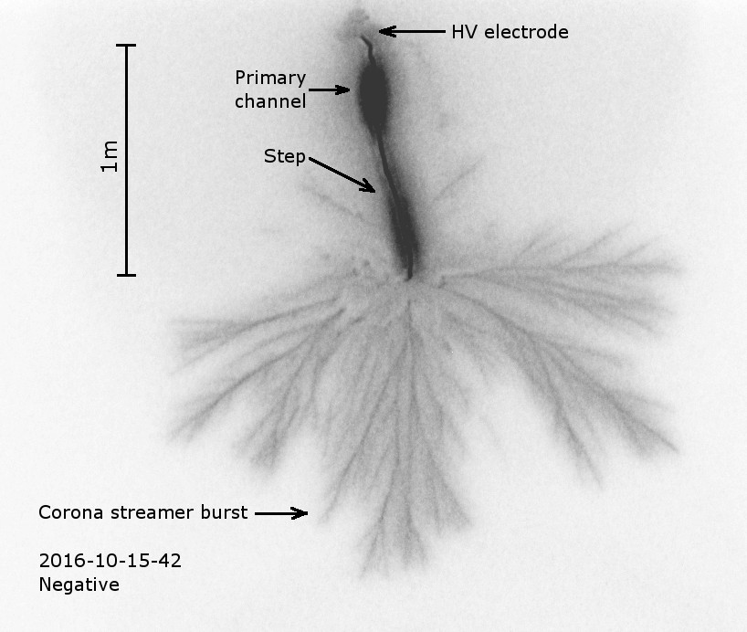
Stepped leader in
negative spark

Slide 16
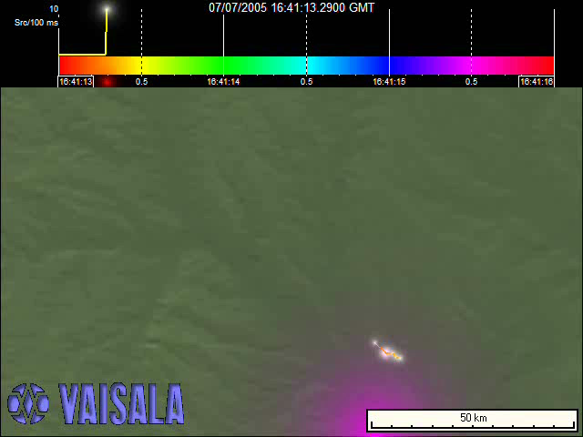
VHF Lightning Image - Animation
3 s
50 km
Courtesy of Dr. K.L. Cummins and Vaisala
16

Slide 17
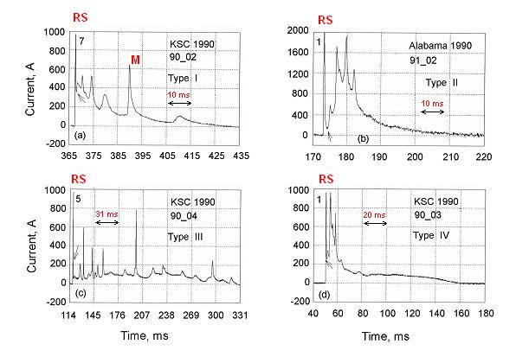
Channel-Base Currents Records
Examples of continuing-current waveshapes in triggered lightning. In each figure, the arrow indicates the assumed beginning of the continuing current. The number in the upper left corner indicates the order of the return stroke in the flash. (a) Type I, more or less exponential decay with superimposed M-current pulses; (b) type II, a hump with superimposed M-current pulses followed by relatively smooth decay; (c) type III, a slow increase and decrease in current, with superimposed M-current pulses throughout; (d) type IV, a hump with superimposed M-current pulses followed by a steady plateau without pronounced pulse activity. Adapted from Fisher et al. (1993).
17
Notes:
17

Slide 18
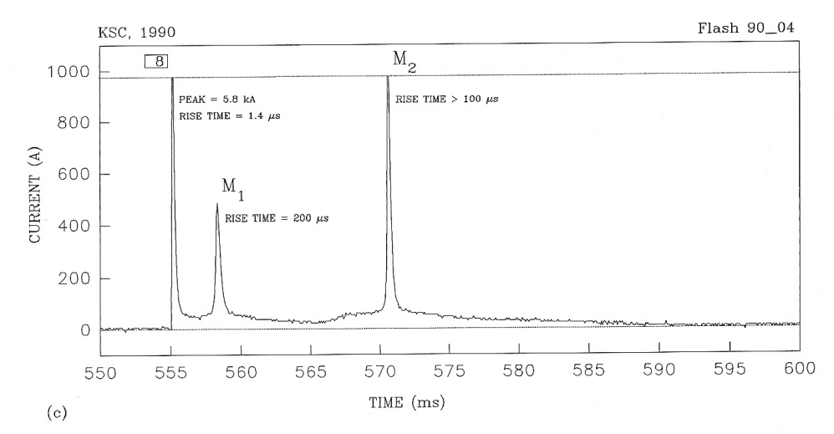
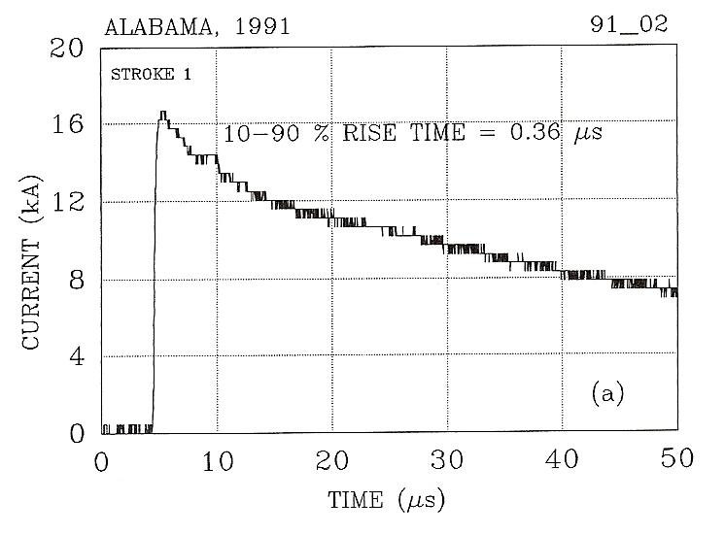
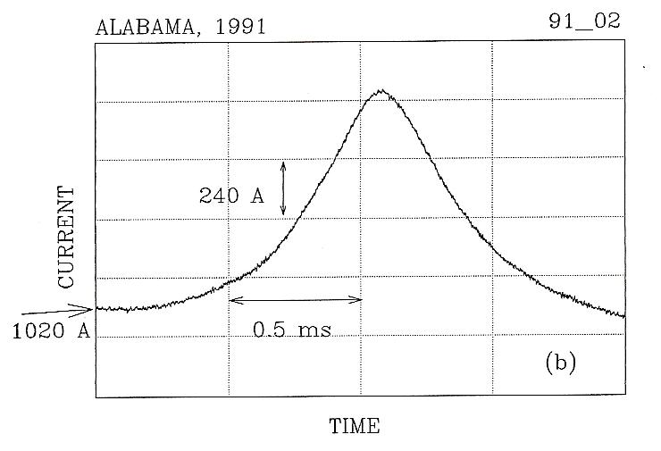
Return Strokes vs. M-components
Portion of current record showing return stroke and two M-component pulses with a 1 kA saturation level. Adapted from Fisher et al. (1993).
M-component
RS
Examples of typical current pulses. (a) A typical return stroke pulse with a fast wave front and slower tail. (b) A typical M-component pulse with a more or less symmetrical wave shape. Note the more than 3 orders of magnitude difference in rise time. Adapted from Fisher et al. (1993).
18
Notes:
18

Slide 19
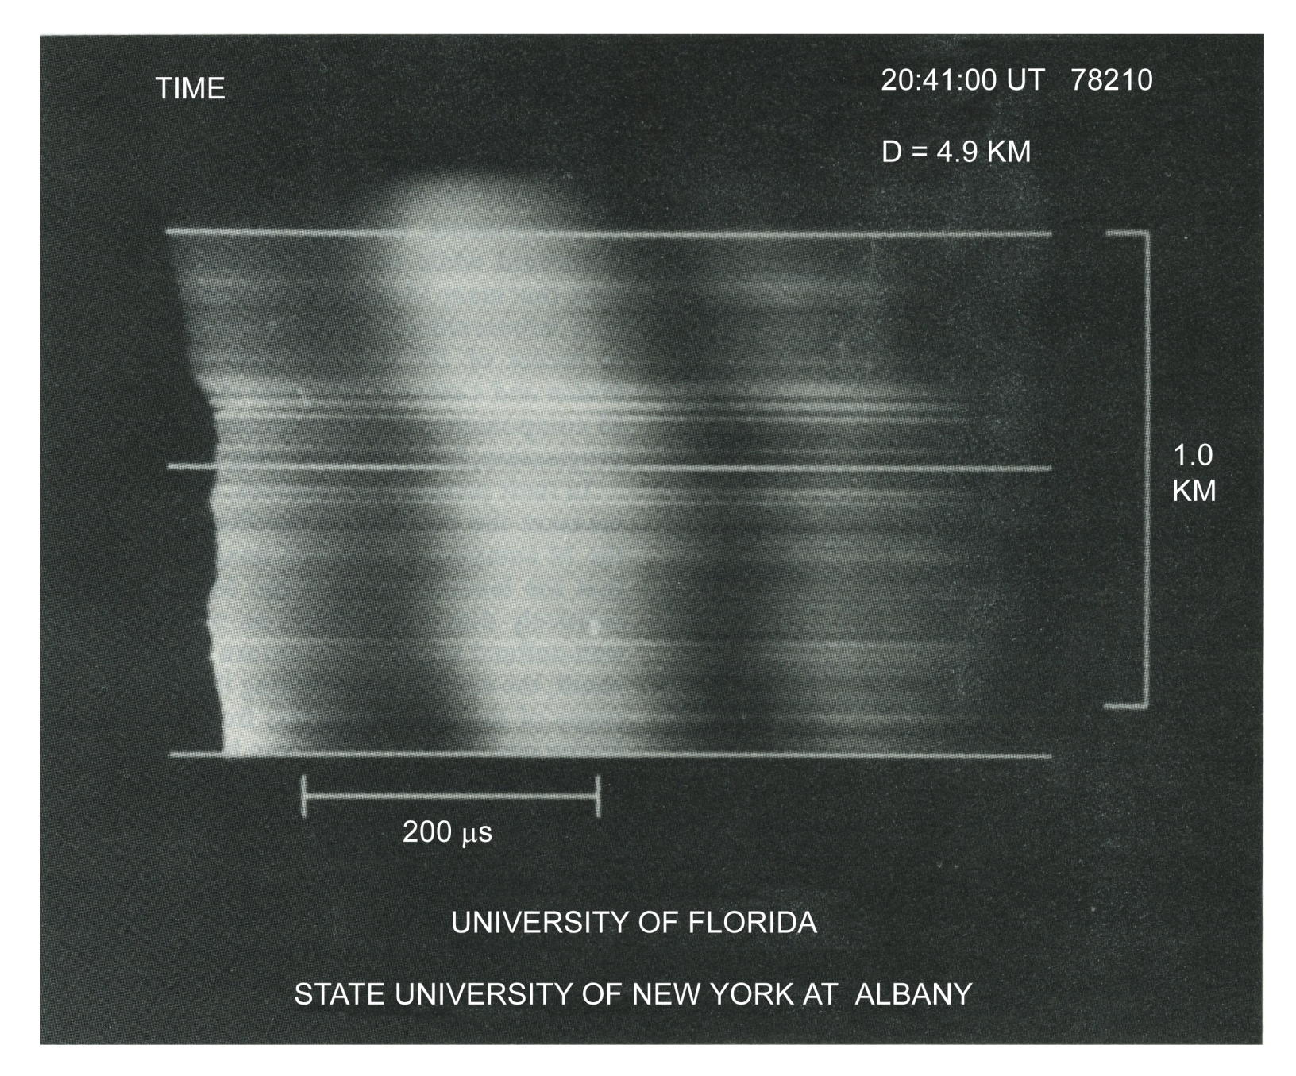
M1
RS
M2
Streak-camera photograph of a return stroke and two associated M-components for a flash that occurred in Florida 29 July 1978 at distance 4.9 km. The heights indicated by the three horizontal lines correspond to the relative light intensity profiles shown on the next slide. Adapted from Jordan et al. (1995).

Slide 20
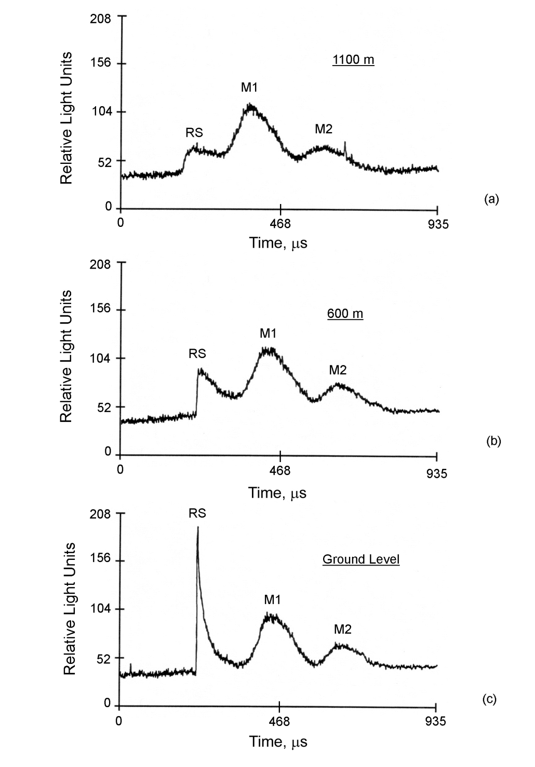
The relative light intensity profiles at (a) 1100 m above ground, (b) 600 m above ground, and (c) ground level corresponding to the streak-camera photograph shown on the previous slide. The profiles show a return-stroke light pulse (RS) followed by two M-component light pulses (M1 and M2). Adapted from Jordan et al. (1995).
What is M-component? A return-stroke-like process without a leader or a leader-like process without a return stroke?

Slide 21
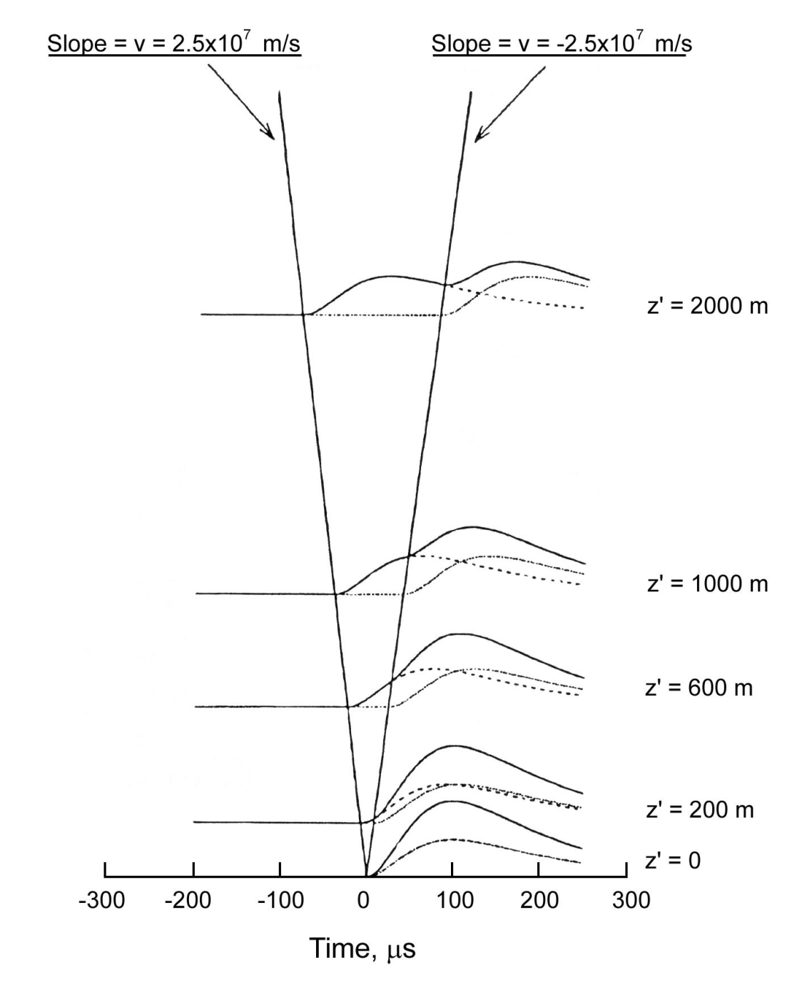
M-component waveforms at different heights along the channel, as predicted by the “guided-waves” model. At t = 0, the incident wave front arrives at ground. The solid, broken, and dotted lines indicate respectively the total current, the incident wave and the reflected wave. At z’ = 0, the incident and reflected waves coincide with each other. The slopes of the slanting lines give the speeds of the incident and reflected waves, 2.5 × 10⁷ and -2.5 × 10⁷ m/s, respectively. Adapted from Rakov et al. (1995).
Cloud base

Slide 22
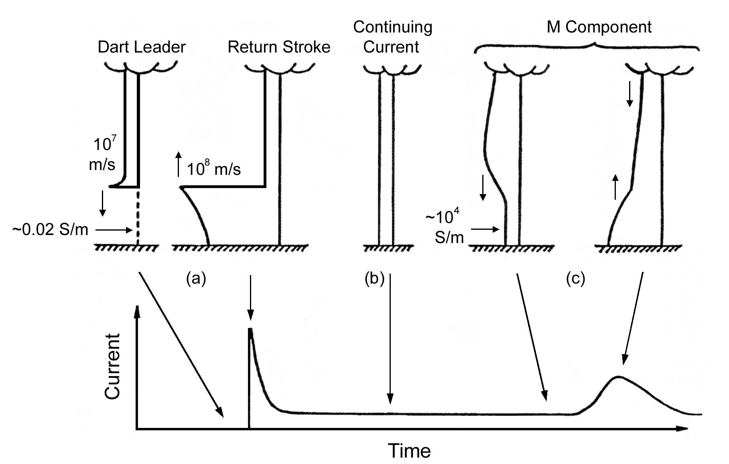
Downward Negative Lightning Discharges to Ground
Continuing
Current
M Component
Dart Leader
Return Stroke
10⁴ S/m
10⁴
S/m
Grounding impedance is much smaller that the channel impedance (short-circuit conditions)
Schematic representation of current versus height profiles for three modes of charge transfer to ground in negative lightning subsequent strokes: (a) dart leader/return stroke sequence, (b) continuing current, and (c) M-component. The corresponding current versus time waveform represents current at the ground. Adapted from Rakov et al. (2001).
22
Notes:
22

Slide 23
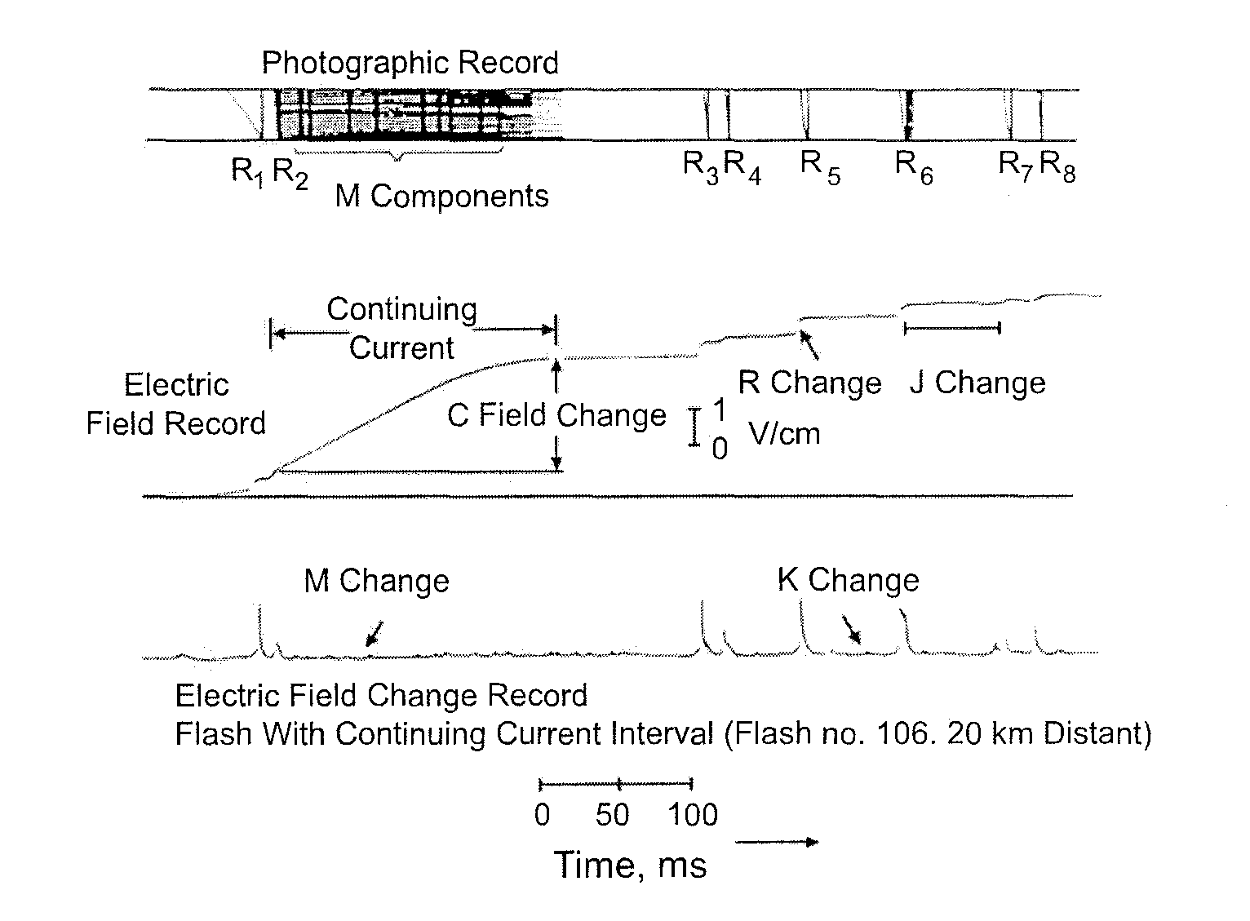
↓
τ = 4 s, low gain
↓
τ = 70 µs,
high gain

Slide 24
Downward Negative Lightning Discharge to Ground (-CG)
Section 3
Section 4a
(PB and
Leaders)
Cloud Charge Distribution
Preliminary
Breakdown
Stepped
Leader
t = 0
1.00 ms
1.10 ms
1.20 ms
Attachment
Process
First Return
Stroke
Section 4b
(AP, Return
Stroke, K and
J Processes
19.00 ms
20.00 ms
20.10 ms
20.20 ms
K and J Process
Dart
Leader
Second Return
Stroke
40.00 ms
60.00 ms
61.00 ms
62.05 ms
A drawing illustrating various processes comprising a negative cloud-to-ground lightning flash (not shown are continuing current and M-components). Adapted from Uman (1987).
24
Notes:
24

Slide 25
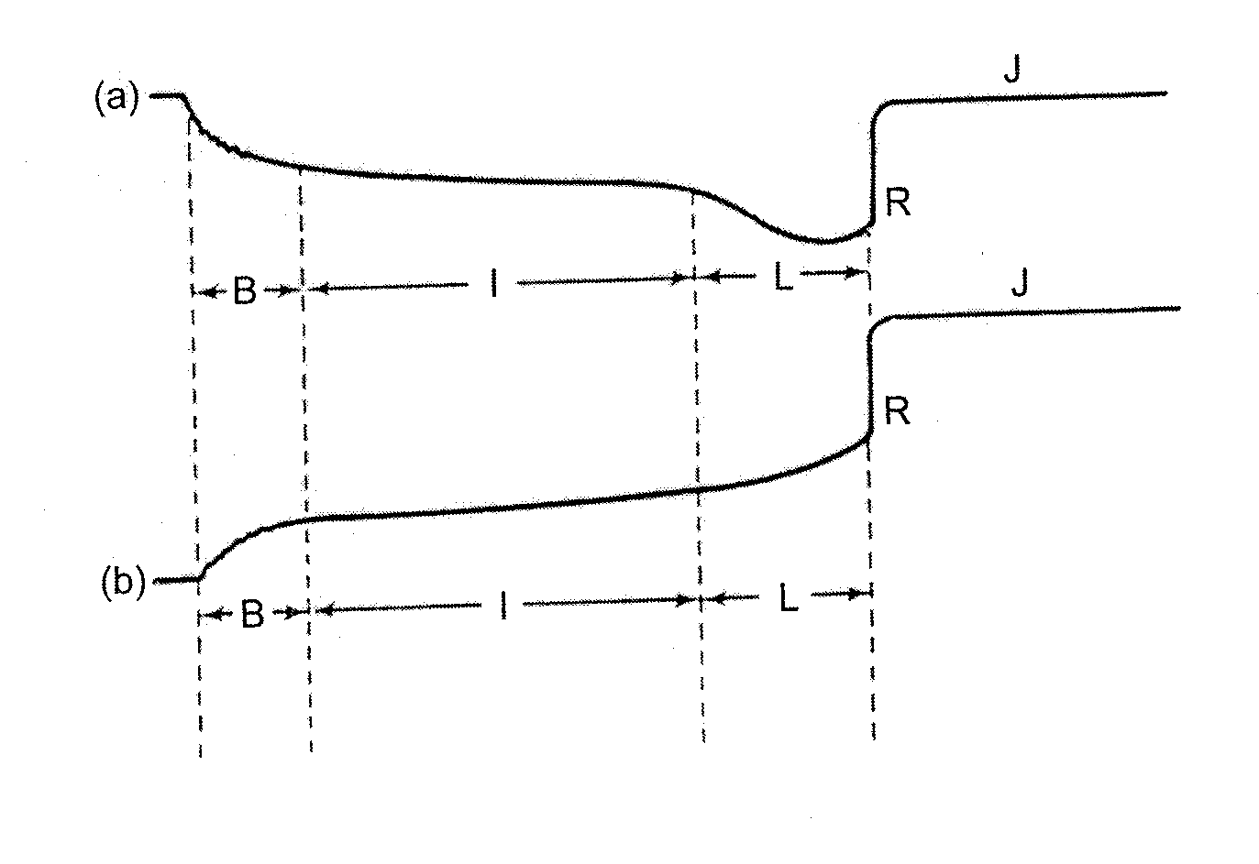
PB
AE sign convention
B = preliminary breakdown
I = intermediate stage
(not always present)
L = stepped leader
R = return stroke
J = J (junction) process
Examples of electric field waveforms of the type used by Clarence and Malan (1957) to
introduce the so‑called BIL structure of the electric field prior to the first return stroke and to interpret the B stage as a vertical discharge between the main negative charge center and the lower positive charge center in the cloud: (a) field at 2 km, (b) field at >5 km. Adapted from Clarence and Malan (1957).

Slide 26
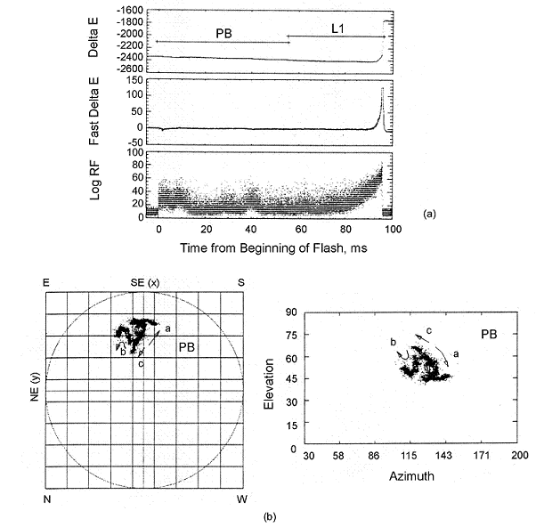
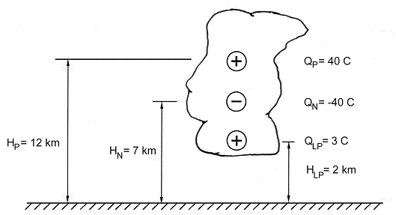
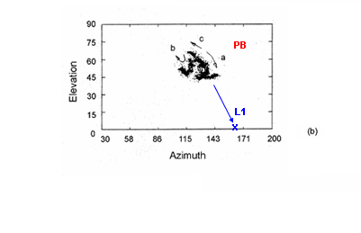
Initial (preliminary) breakdown in ground discharges (CGs)
PB
L1
A vertical tripole representing the idealized gross charge structure of a thundercloud. Initial breakdown is shown to occur between the main negative and lower positive charge centers. The lower positive charge region (LPCR) serves to enhance the electric field at the bottom of the main negative charge region and is often viewed as an “ignition cell” in the initiation of cloud-to-ground lightning.
L1
x
PB
PB
PB
L1
x
Initial (preliminary) breakdown in a cloud-to-ground discharge: (a) time waveforms from the beginning of the flash to the first return stroke with the preliminary breakdown indicated by PB and leader indicated by L1, (b) the radiation (274 MHz) sources of PB. Adapted from Shao (1993).
PB produced 3 branches,
a, b, and c before launching
stepped leader L1.
26

Slide 27
Preliminary breakdown (PB) sequentially produced 3 branches, a, b, and c, in the cloud before launching stepped leader L1.
Stepped leader L1 extends
downward and attaches
to the ground

Slide 28
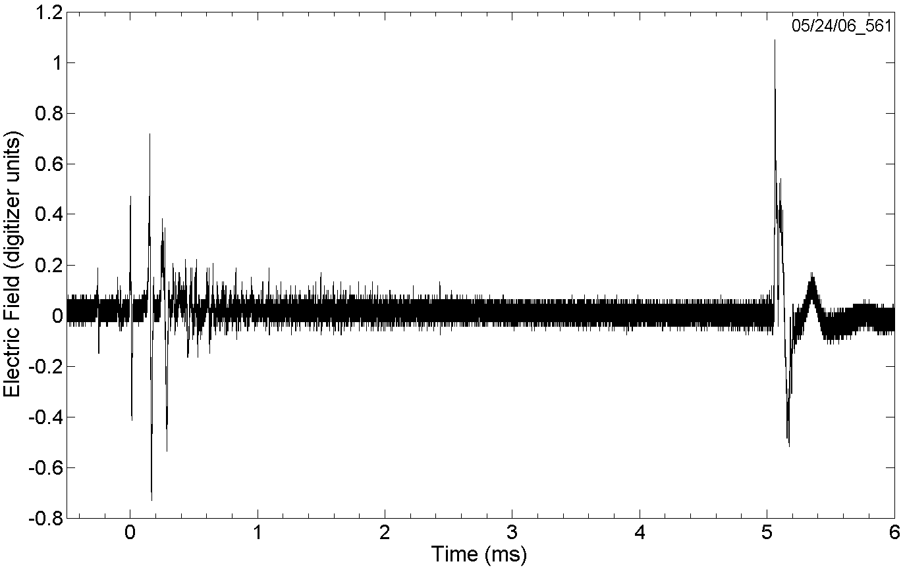
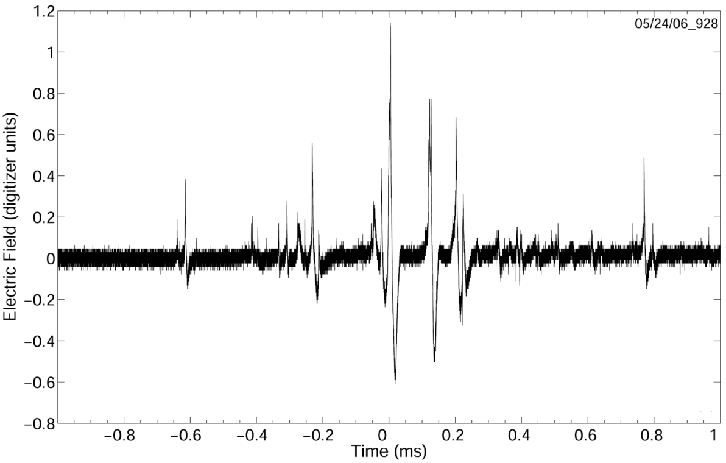
Preliminary Breakdown Pulse Trains
Preliminary-Breakdown
Pulse Train
1st RS
Preliminary breakdown pulse train and the first return-stroke pulse of cloud-to-ground lightning flash
- CG
Preliminary breakdown pulse train of attempted leader (intracloud lightning discharge)
Attempted Leader
28
Notes:
28

Slide 29
PB
AE sign convention
2 km
B = preliminary breakdown
I = intermediate stage
(not always present)
L = stepped leader
R = return stroke
J = J (junction) process
5 km
Examples of electric field waveforms of the type used by Clarence and Malan (1957) to
introduce the so‑called BIL structure of the electric field prior to the first return stroke and to interpret the B stage as a vertical discharge between the main negative charge center and the lower positive charge center in the cloud: (a) field at 2 km, (b) field at >5 km. Adapted from Clarence and Malan (1957).

Slide 30
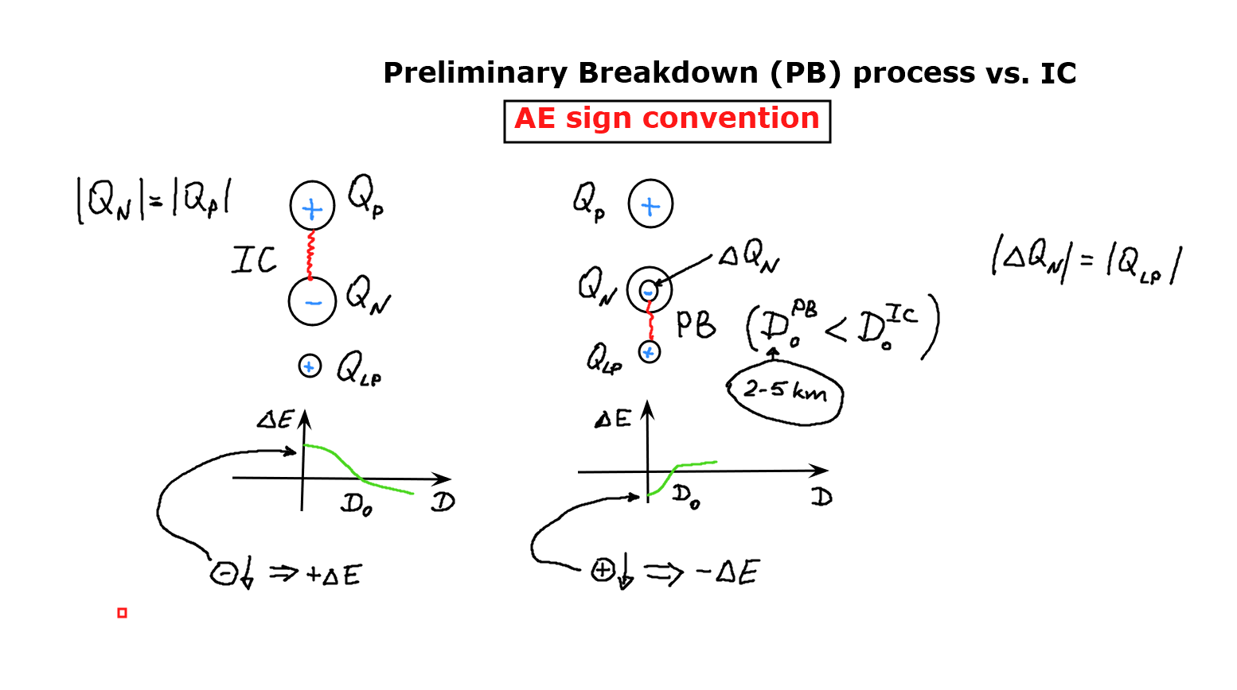

Slide 31
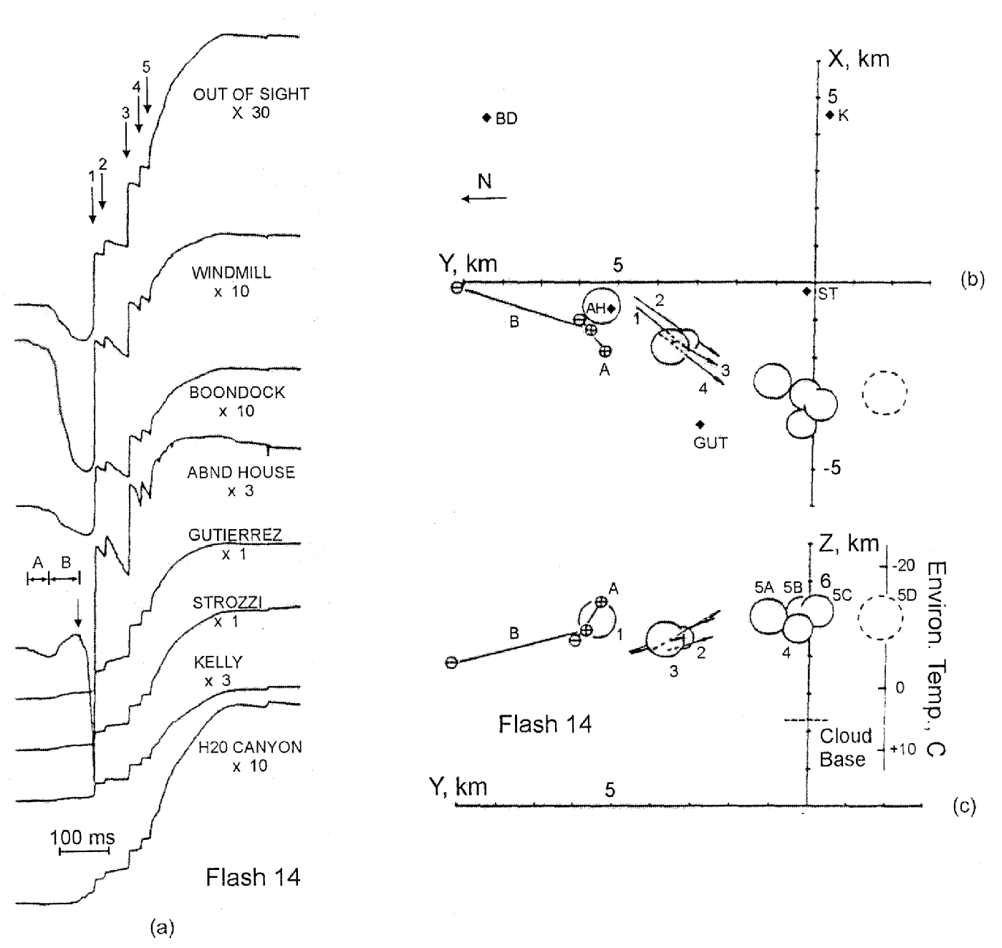
E-fields of a 5-stroke flash measured at 8 stations in NM
Inferred cloud charged neutralized by the 5 strokes
Preliminary breakdown
(A + B)

Slide 32
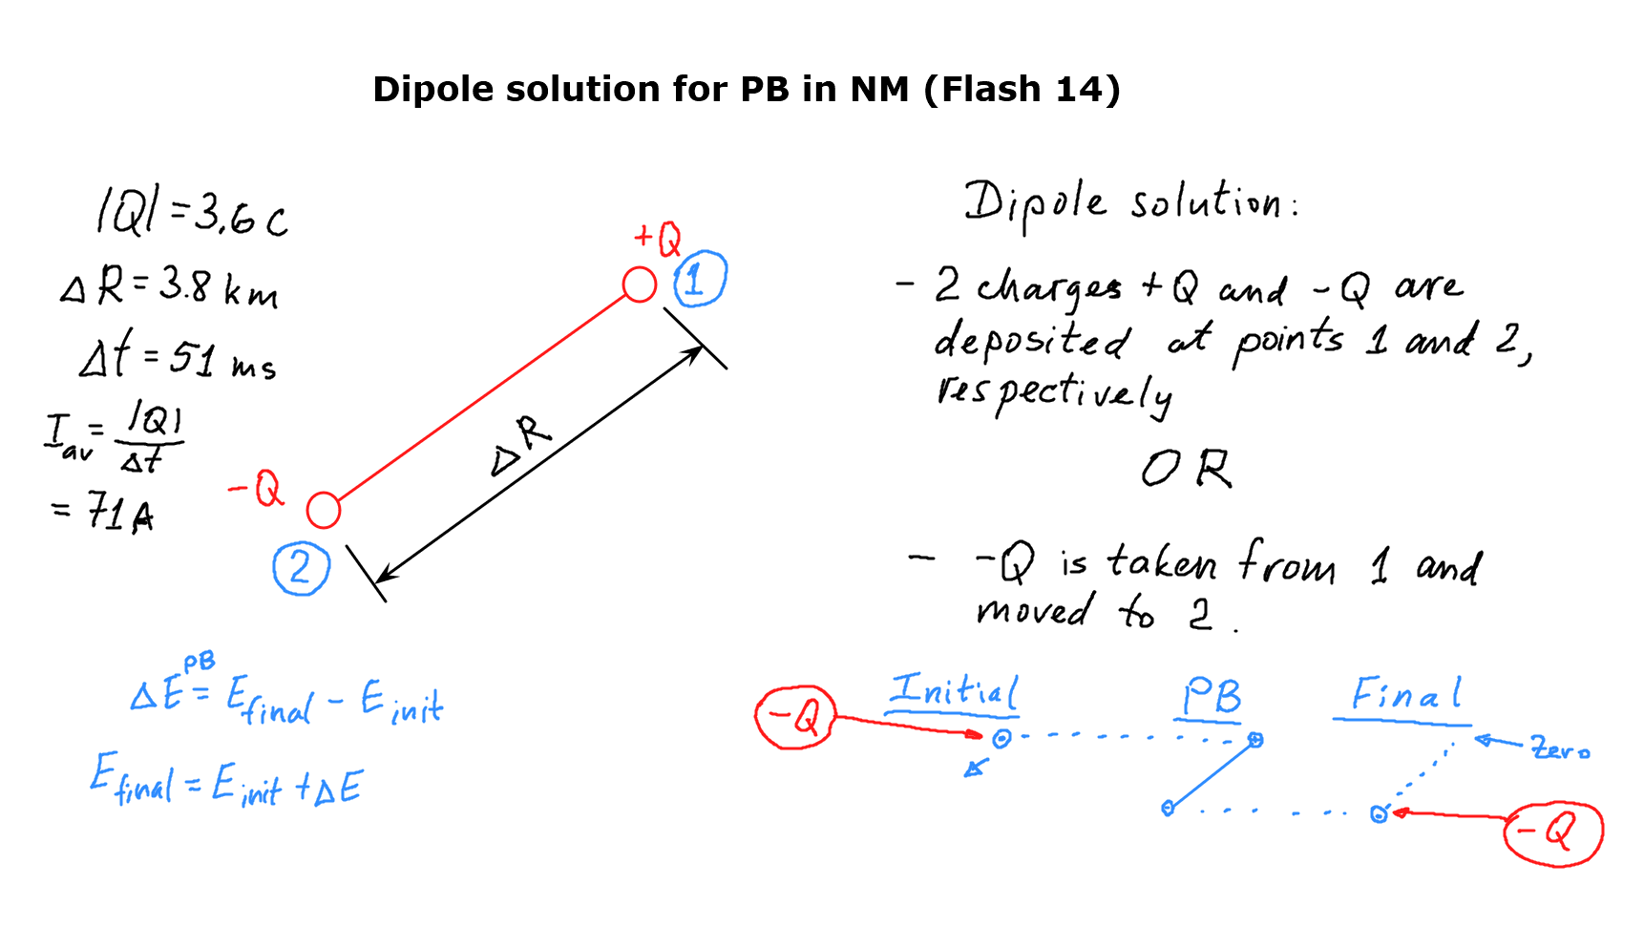

Slide 33
Downward Negative Lightning Discharge to Ground (-CG)
Section 3
Section 4a
(PB and
Leaders)
Cloud Charge Distribution
Preliminary
Breakdown
Stepped
Leader
t = 0
1.00 ms
1.10 ms
1.20 ms
Attachment
Process
First Return
Stroke
Section 4b
(AP, Return
Stroke, K and
J Processes
19.00 ms
20.00 ms
20.10 ms
20.20 ms
K and J Process
Dart
Leader
Second Return
Stroke
40.00 ms
60.00 ms
61.00 ms
62.05 ms
A drawing illustrating various processes comprising a negative cloud-to-ground lightning flash (not shown are continuing current and M-components). Adapted from Uman (1987).
33
Notes:
33

Slide 34
Course Sections | Number of Lectures | HW Due (Can-vas) | Test (Honor-lock) | Section in Course Packet | Chapter/ Sections in Text (FOL)
Introduction | 1
1. Types of lightning discharges and lightning terminology | 4 | HW1 01/25 | T1 01/27 | 1 | 1, App. 1, 4
2. Incidence of lightning to areas and structures | 4 | HW2 02/05 | T2 02/08 | 2 | 2, Sect. 9.3
3. Electrical structure of thunderstorm clouds | 6 | HW3 02/22 | T3 02/24 | 3 | 3, App. 2
4a. Properties of the negative lightning discharge to ground - I | 5 | HW4 03/08 | T4 03/10 | 4a | 4.1-4.3, 4.6, 4.10
4b. Properties of the negative lightning discharge to ground – II | 4 | HW5 03/19 | T5 03/22 | 4b | 4.4-4.5, 4.7-4.10, 9.3

Slide 35
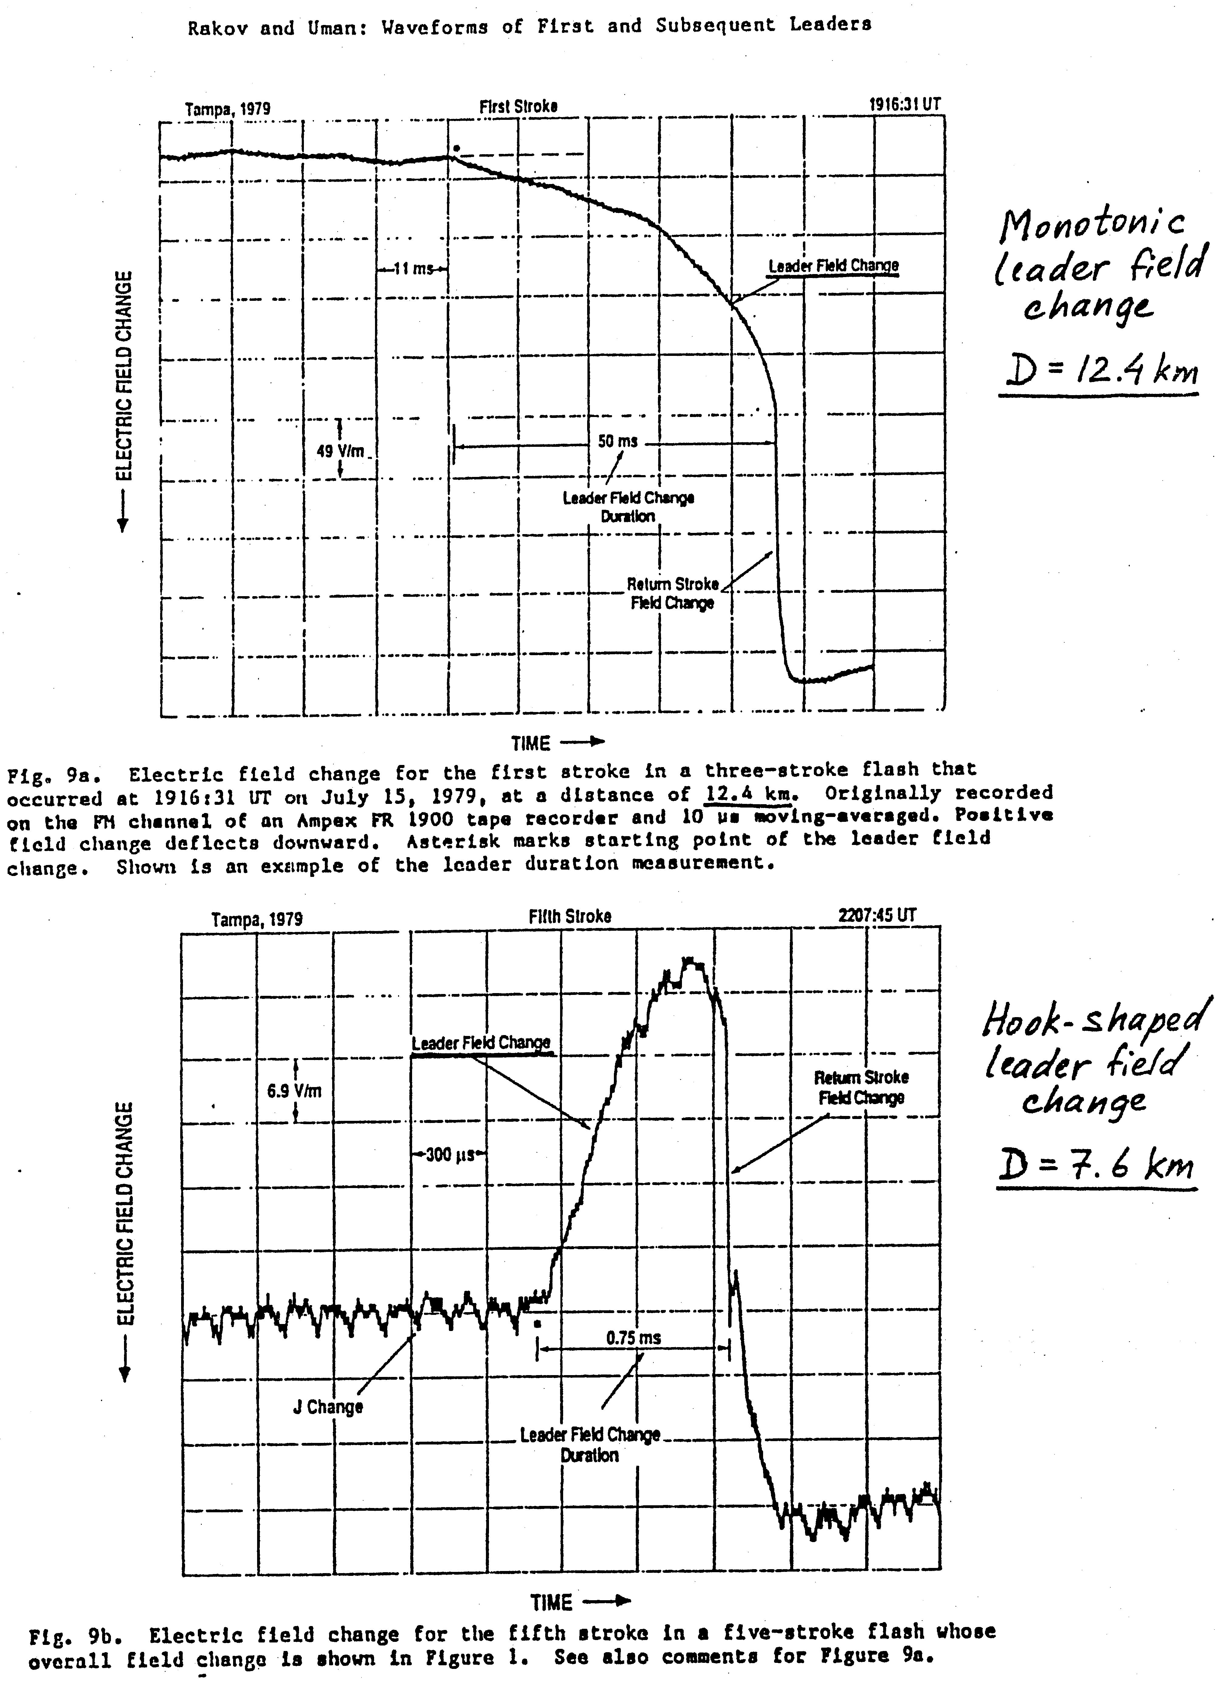

Slide 36
ΔE = E_{ch} + E_{s}

Slide 37
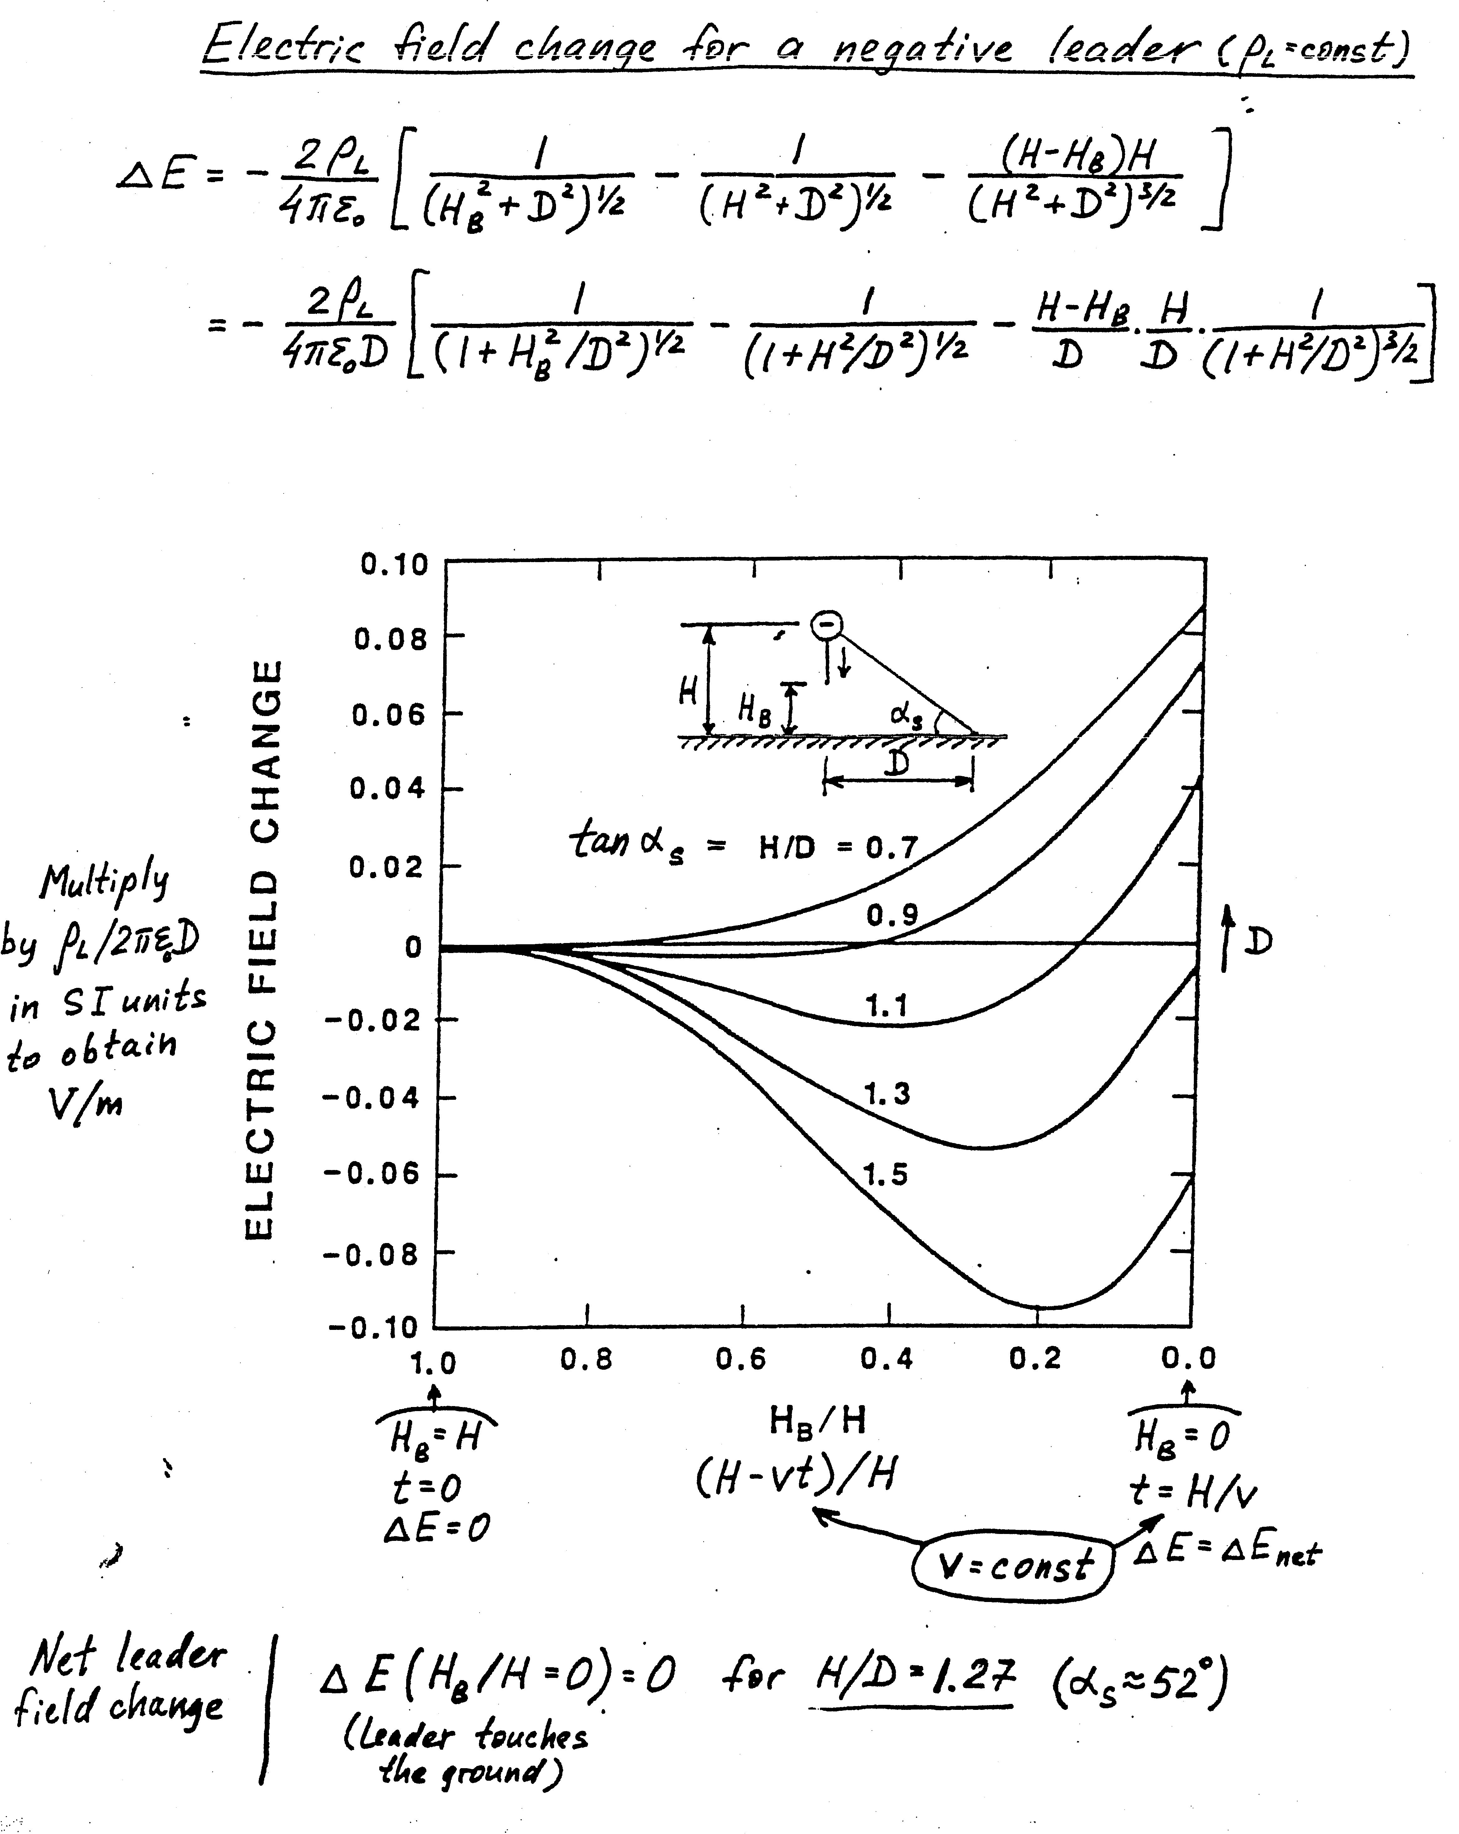
1 monotonic, positive and 2 hook-shaped, positive
2 hook-shaped, negative

Slide 38
Zero-crossing at D = 6 km; the corresponding H = 1.27D = 7.6 km

Slide 39
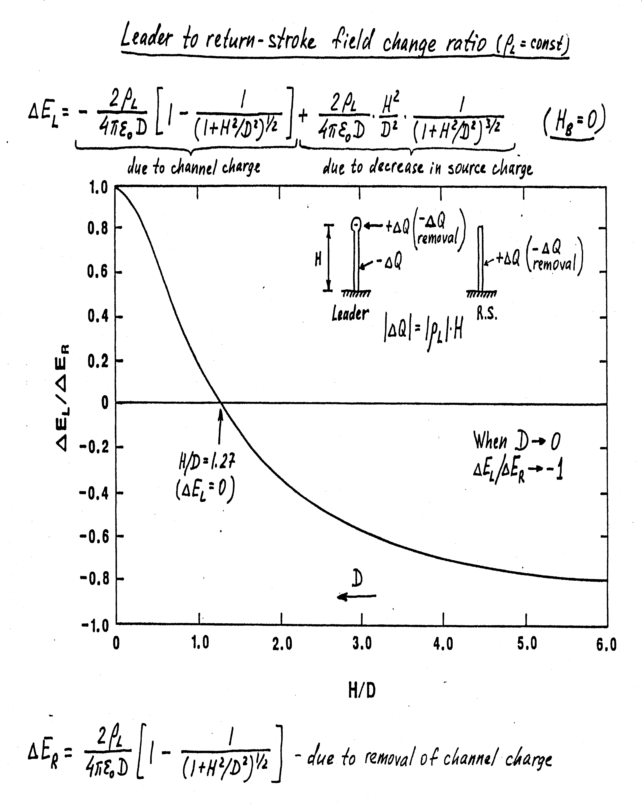
At D = ∞ →

Slide 40
<5 km
6-9 km
>10 km
HN=hook-shaped, negative
HP=hook-shaped, positive
MP=monotonic positive
←Zero level
<5 km
6-9 km
>10 km
These are dominant waveshapes for 1st strokes; for strokes #8-18, HN is dominant at all distances.

Slide 41
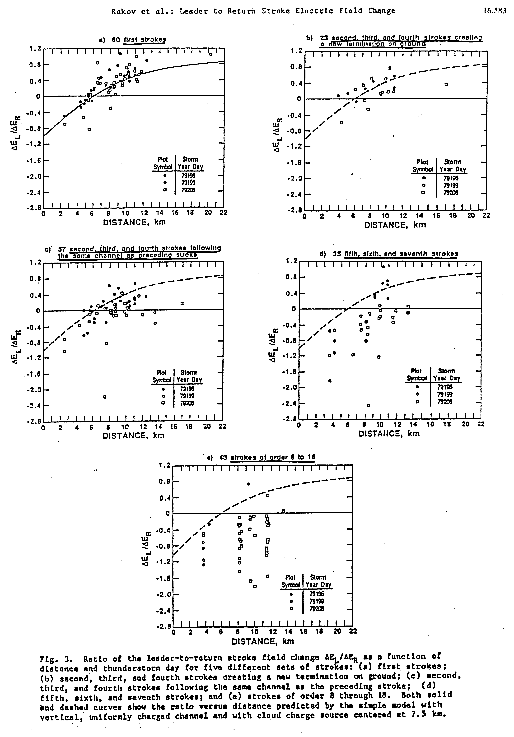
First strokes
Strokes 2-4
(new termination)
Strokes 2-4
(in the same
channel)
Strokes 5-7
Strokes 8-18

Slide 42
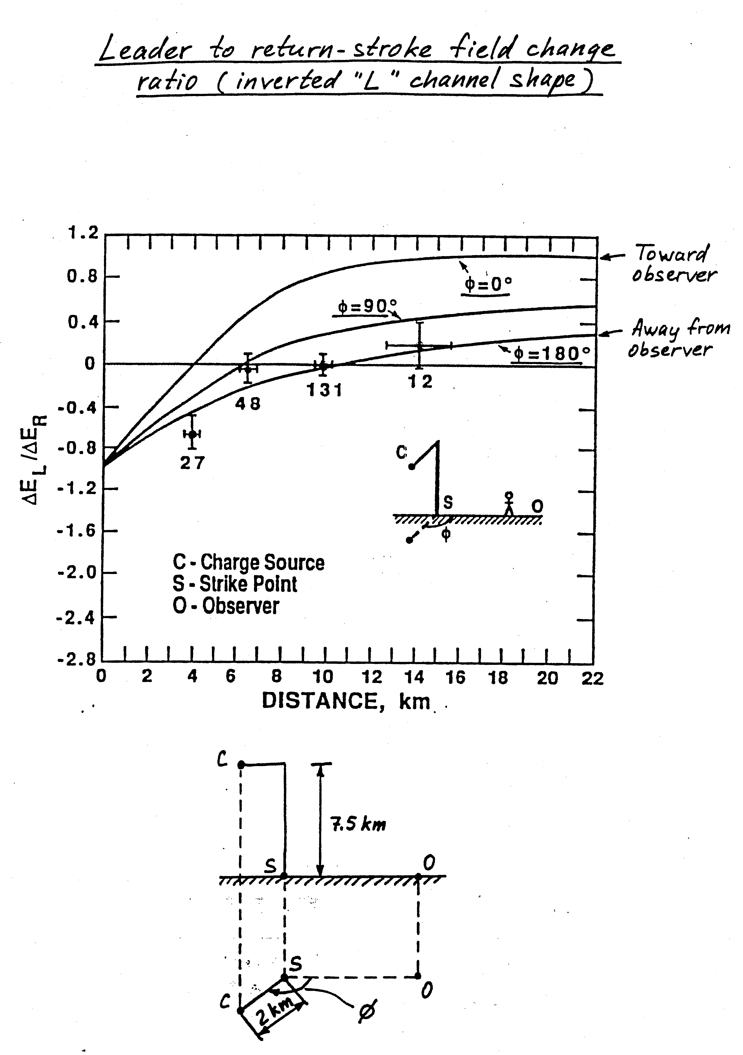

Slide 43
LPCR
43
Notes:
43

Slide 44
Cloud electric charge structure
+
-
+
A vertical tripole representing the idealized gross charge structure of a thundercloud such as that shown in the left panel; the negative screening layer charges at the cloud top and the positive corona space charge produced at ground are ignored here. The lower positive charge region (LPCR) serves to enhance the electric field at the bottom of the main negative charge region and is often viewed as an “ignition cell” in the initiation of cloud-to-ground lightning.

Slide 45
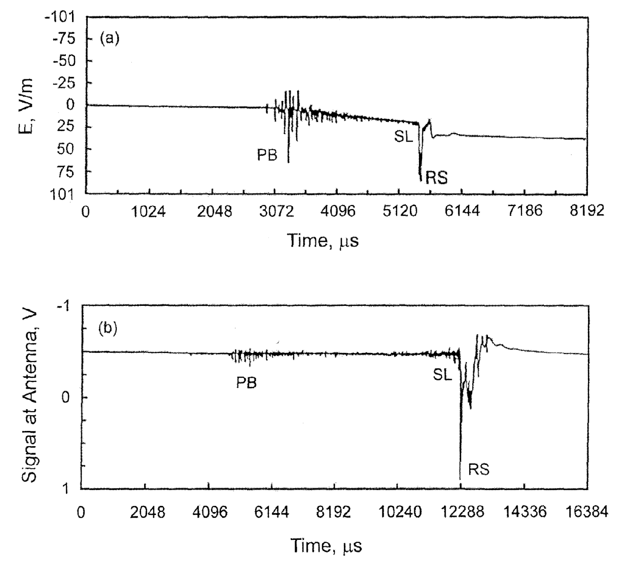
Fig. 4.11

Slide 46
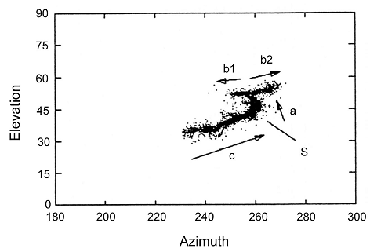
Initial (preliminary) breakdown in cloud discharges (ICs)
b1
b2
a
c
S
A vertical tripole representing the idealized gross charge structure of a thundercloud. Initial (preliminary) breakdown is shown to occur between the main negative and main positive charge centers.
All the VHF radiation sources in azimuth-elevation format for a Florida cloud flash (IC). The sources exhibited a two-level structure, the upper-level channels, b1, and b2, and the lower-level channel, c, being connected by a vertical channel, a.
S denotes the region where the flash started and the arrows indicate the direction of motion of negative charge.
Channel a is fully formed during the first 20 ms, channels b1 and b2 during the following 100 ms or so, and channel c during the last 200 ms or so. Adapted from Shao and Krehbiel (1996).
46

Slide 47
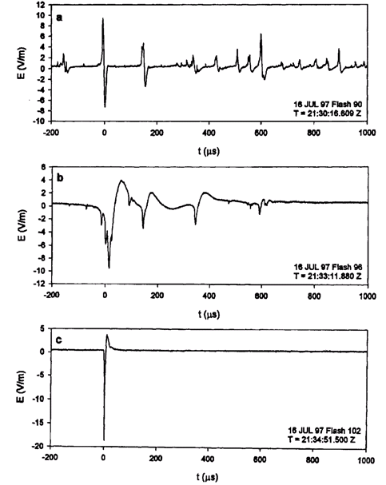
Initial (preliminary) breakdown in ground (CGs) and cloud (ICs) discharges
Typical total duration : 20-40 μs
Typical Interpulse intervals : 70-130 μs
CG
Typical total duration : 50-80 μs Typical Interpulse intervals : 600-800 μs
IC
Typical total duration : 10-30 μs
CID
Examples of electric field pulse waveforms characteristic of (a) the initial breakdown in negative ground flashes (b) the initial breakdown in cloud flashes, and (c) the compact intracloud discharges.
47

Slide 48
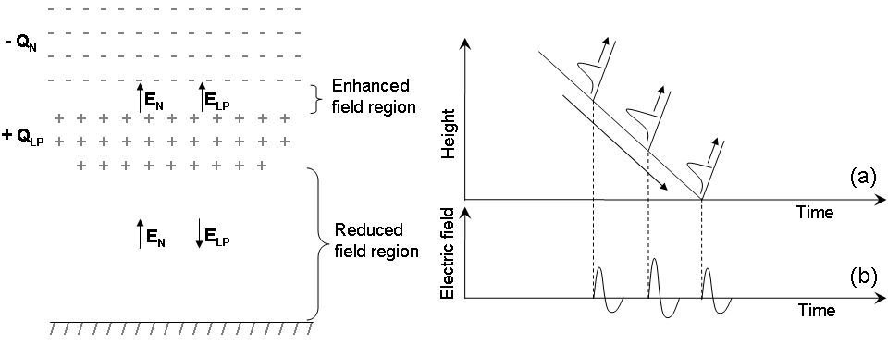
Role of Lower Positive Charge Region in Facilitating Different Types of Lightning
Left panel is a schematic illustration (not to scale) of electric field enhancement and reduction effects of the lower positive charge region (+Q_{LP}) below the main negative charge region (-Q_{N}). The main positive charge region is not shown. Arrows indicate the direction of vertical components of electric field vectors. The total electric field is enhanced, (E_{N} + E_{LP}), between the negative and positive charge regions and reduced, (E_{N} – E_{LP}), below the positive charge region.
Right panel shows (a) schematic representation of preliminary breakdown stepping process in negative ground flashes. Negatively-sloped arrow indicates the overall downward extension of negatively charged channel through the LPCR. Three steps giving rise to current (and light) pulses are shown. Each current pulse originates at the tip of downward-extending channel and propagates upward (positively-sloped arrows). (b) A sketch of expected electric field record of resultant wideband PB pulse train.
48

Slide 49
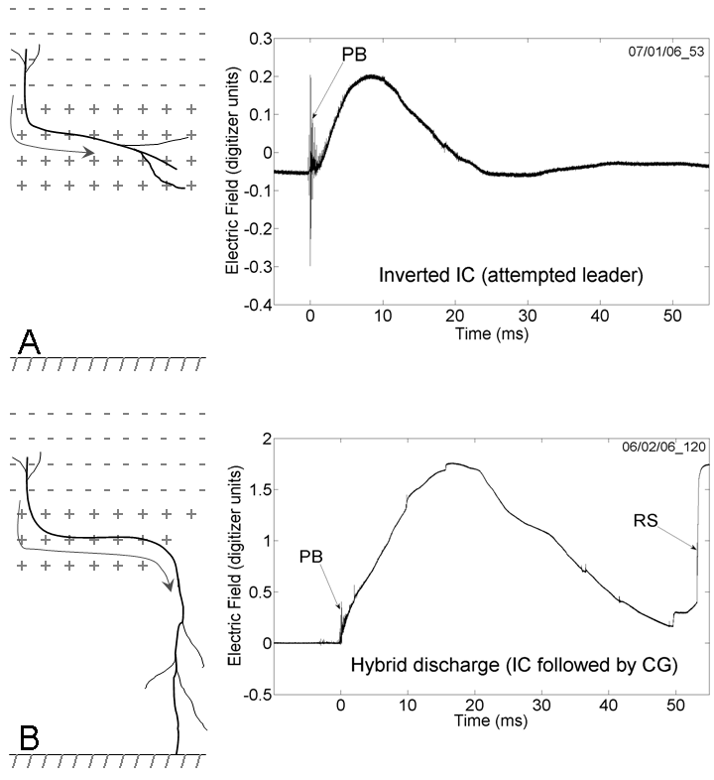
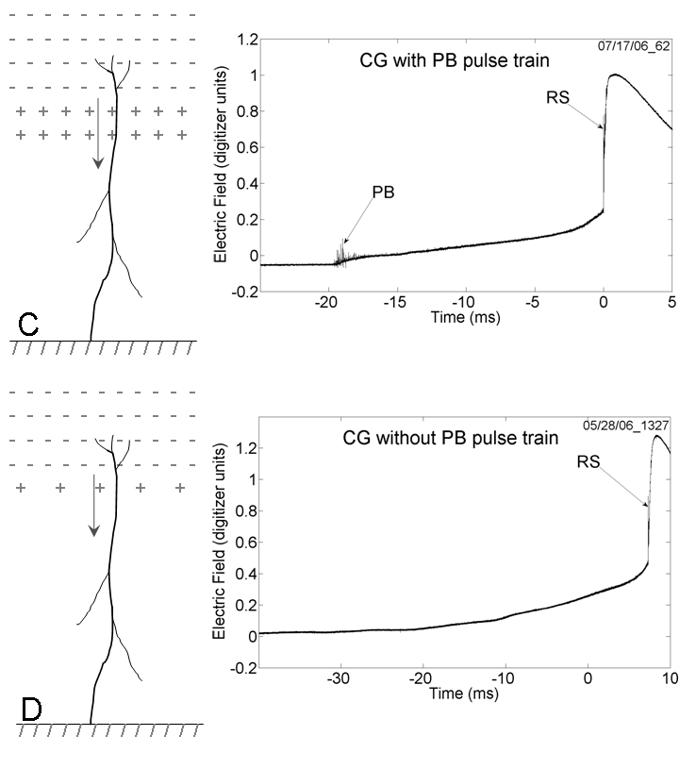
The left panels, A-D, schematically show four types of lightning that may arise depending upon the magnitude of the LPCR. The charge configuration in each of the scenarios represents only its vertical profile (no lateral boundaries are shown). Arrows indicate the direction of propagation of negative leader. The corresponding examples of expected electric field signatures are shown in the right panel.
The field waveforms are from four different thunderstorms recorded at some tens of kilometers in Gainesville, Florida, using the same instrumentation with a decay time constant of 10 ms.
PB = preliminary breakdown pulse train, RS = return-stroke waveform.
49
Notes:
49

Slide 50
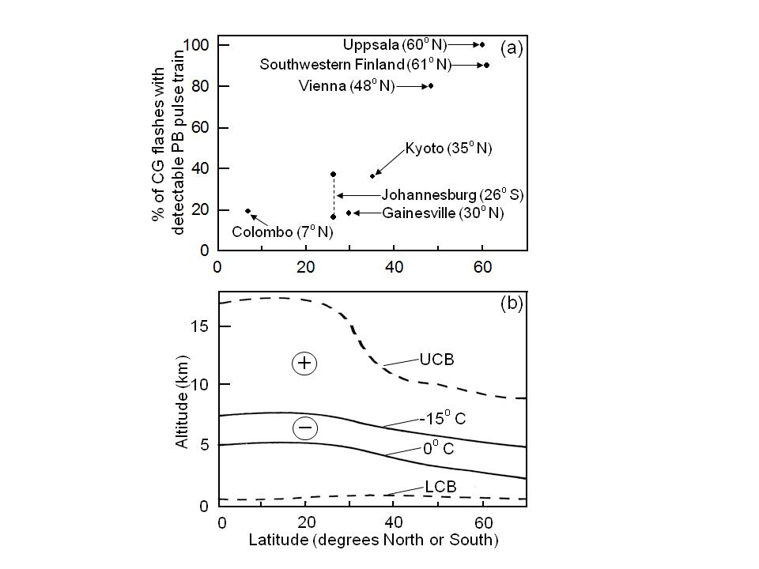

Slide 51
Negative leader stepping
51
Notes:
51

Slide 52
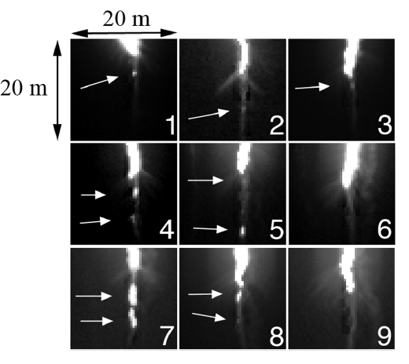
Downward Negative Leader Stepping Mechanism
The bottom 20 m of the downward‐extending leader channel of a triggered-lightning flash (Camp Blanding, Florida) in the nine high-speed video frames (240 kfps, 4.17 us per frame). Each image shows about 20 m × 20 m. The white arrows point to the luminous segments, 1 to 4 m in length, that formed separately from and 1 to 10 m below the downward extending leader channel. The leader traveled 100 m from frame 1 to frame 9 where it was 30 m above its termination point. The return stroke began during frame 10. Adapted from Biagi et al. (2010).
52

Slide 53
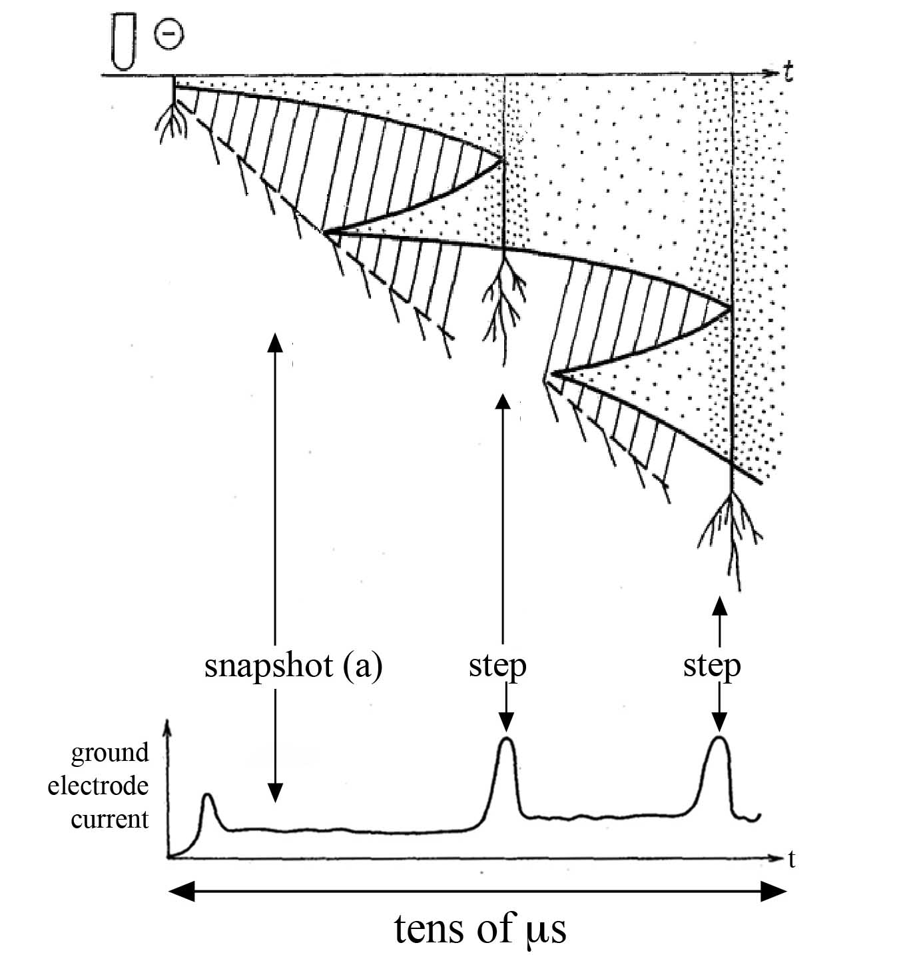
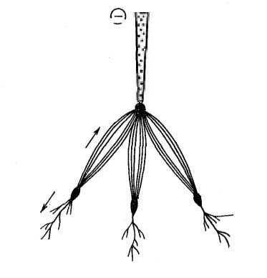
Downward Negative Leader Stepping Mechanism
Gorin et al. [1978]
HV cathode
time
primary leader channel
space
leader
primary leader channel
positive
streamers
streamer
zone
~ 2 m
space stem
negative
streamers
53

Slide 54
The leader tip seen in frames 10 (left) and 11 (right) of HS video (108 kfps, 9.26 us per frame, r = 440 m) of altitude triggered flash at Camp Blanding, Florida. The top frames are intensity inverted, but otherwise unenhanced. The bottom frames are intensity inverted and contrast-enhanced in order to make visible the space stem in frame 10 and the corona streamers and corona envelope around the leader in frame 11. The double-ended arrow represents 5 m in length, and it is in the same position in both frames. Adapted from Biagi et al. (2014).

Slide 55
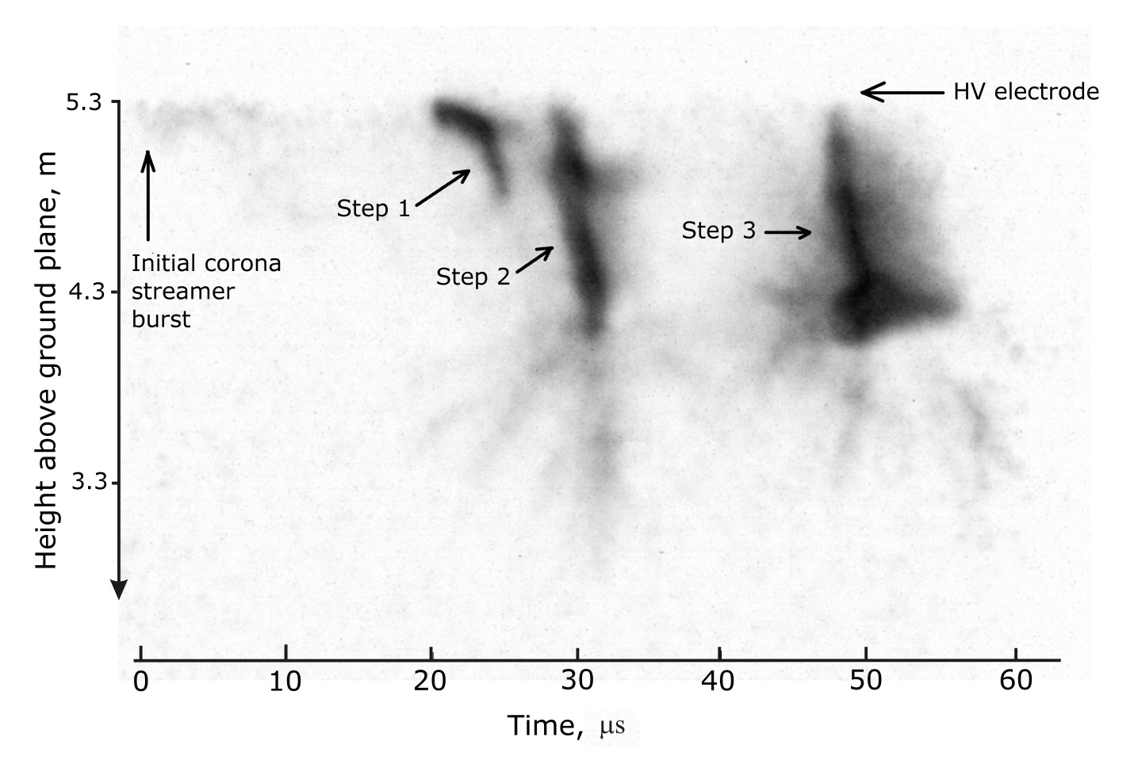

Slide 56
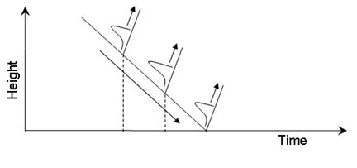
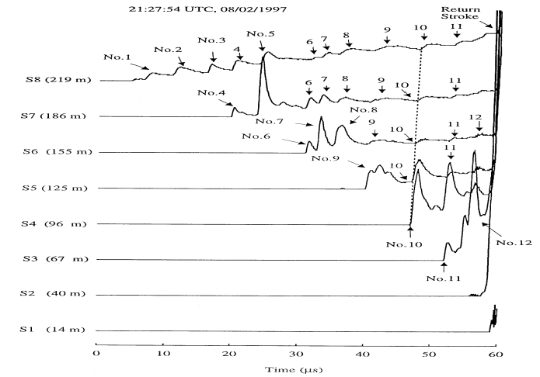
Downward Negative Leader Stepping Mechanism
Schematic representation of stepping process. Negatively-sloped arrow indicates the overall downward extension of negatively charged channel. Three steps giving rise to current (and light) pulses are shown. Each current pulse originates at the tip of downward-extending channel and propagates upward (positively-sloped arrows). Adapted from Nag and Rakov (2009).
Dart-stepped leader light versus time waveforms at different heights above ground (100-ns time and 30-m spatial resolution) for a flash triggered at Camp Blanding, Florida. Light pulses associated with individual steps are numbered. Adapted from Wang et al. (1999c).
56
Notes:
56

Slide 57
M-component vs. Leader/Return Stroke Sequence
57
Notes:
57

Slide 58
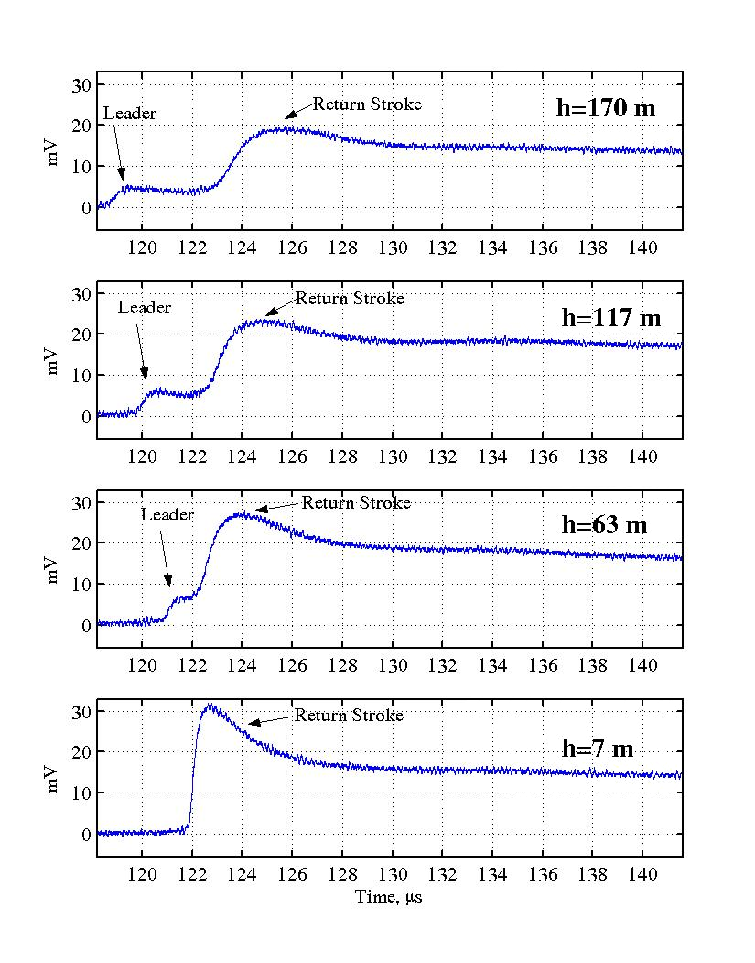
Optical Measurements of Return-Stroke Speed
Optical intensity (in millivolts at the input of the oscilloscope) vs. time waveforms at four different heights, 7, 63, 117, and 170 m, above the lightning termination point for stroke 1 in flash F0336. Adapted from Olsen et al. (2004).
58
Notes:
58

Slide 59


Return-Stroke Currents and Close Electric Fields
Channel-base current waveform of the first stroke of triggered-lightening flash S59930 (Camp Blanding, Florida).
V-Shaped electric field waveform at a distance of 15m. The bottom of the V corresponds to the transition from leader to return stroke and the beginning of the channel-base current waveform.
Adapted from Rakov et al. (2005)
59

Slide 60

(a) Channel-base current (b) magnetic field, and (c) electric field for a large M component that followed the second stroke of a rocket-triggered lightning flash at Camp Blanding, Florida. The fields were recorded at a distance of 280 m from the lighting channel.
The left vertical line indicates the position of current pulse onset and the right vertical line the position of negative electric field peak. Note that the onset of the M-component current pulse at the channel base occurs some tens of microseconds before the electric field peak.
Adapted from Rakov et al. (1998).

Slide 61

(a) Measured channel-base current, (b) measured 30 m electric field, and (c) calculated 30 m electric field for an M-component that occurred about 2 ms after the last stroke of the five-stroke flash 9313 triggered at Camp Blanding, Florida. The electric field in (c) was computed using the “guided-wave” model, measured channel-base current in (a), and v = 2.5 × 10⁷ m/s. Adapted from Rakov et al. (1995).

Slide 62

← Channel to ground
M-component
Camp Blanding rocket-and-wire triggered lightning flash. VHF sources mapped by the LMA, which correspond to an M-component observed in the current at ground. The sources (colored red) begin near the farthest extent of previous breakdown (colored black) and travel toward the channel base. Adapted from Pilkey et al. (2013).

Slide 63

Schematic diagram showing formation of two ICC pulses during the initial stage of upward lightning and corresponding current waveforms at the tall-object top. Both low and high (in-cloud) junction point cases are presented. In the case of high junction point, the downward propagating part of return stroke wave is transformed into the long-front, downward M-wave, resulting in the M-component mode of charge transfer to ground. For the low junction point, the mixed mode of charge transfer to ground takes place. Adapted from Zhou et al. (2014).

Slide 64

ICC2 (I_{P}=9.0 kA, RT=7.1 us, HPW=64 us, Icc=10 A) in Flash UF 12-48
The re-illuminated branch was first visible when the initial stage of UF 12-48 started at t = -302 ms and then decayed (became faintly luminous, practically not visible at t = -200 µs). Adapted from Mallick et al. (2014).

